Slide 1
Community e-Connect – XX
Date

Slide 2
Purpose
Share updates and review next steps on implementing Community e-Connect (CeC) in XXX

Slide 3
The What
What is Community e-Connect?
  Bi-directional linkage between clinical Electronic Health Records (EHRs) and community-based organizations (CBOs)
  Utilizes software derived from a Massachusetts pilot funded through a CMS State Innovation Model grant
  Can integrate with nearly any EMR
  CBOs use the web-based e-Referral Gateway to receive referrals and send feedback reports
  SOC2/HIPAA compliant

Slide 5
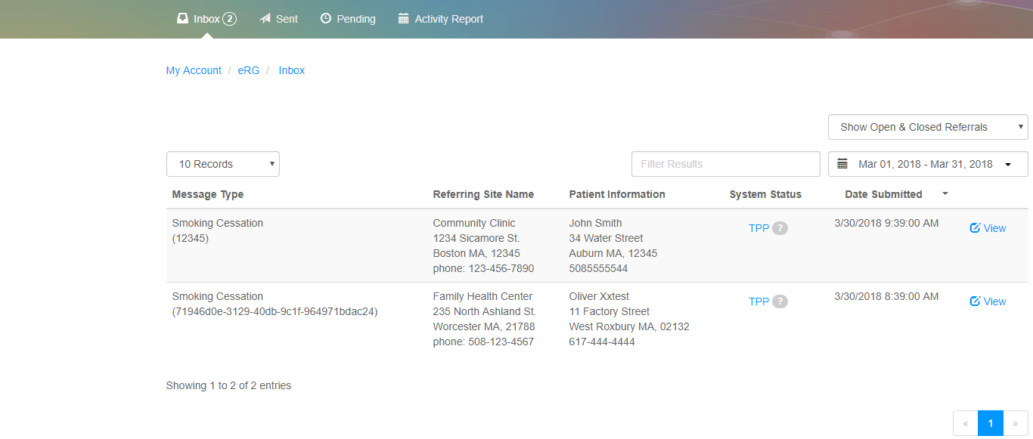
The How: e-Referral Gateway
Initially, community organizations utilize the eRG to receive referrals and send feedback

Slide 6
The How: Implementation Methodology
Phase 1:
Get Ready
Phase 2:
Get Set
Phase 3:
Go Live
Identify partners
Kick off meeting and stakeholder buy-in
Establish legal referral agreements
Define workflows
Determine data elements
Conduct IT assessment
Confirm workflows/data elements with stakeholders
Implement EMR enhancements and configure interfaces
Test referral pathway and data locations
Train staff
Transition to Production
Monitoring and Quality Control
Evaluation

Slide 7
Kick Off and Stakeholder Buy-In
Goals:
Bring together collaborating partners provide
Provide a high-level overview of the project
Obtain shared commitment to the overall goals and objectives of the project as well as the overall approach
Discuss next steps and partner to-do's
Next Steps:
Schedule within a month of determining partners
NACDD prepare presentation depending on intended audience’s knowledge

Slide 8
Legal Agreement
Goals:
Establish a data-sharing MOU between the clinical and community partners
Next Steps:
NACDD share example MOUs
Partners share within respective legal departments for input
Partners collaborate to sign agreement

Slide 9
Trusted Agent Process
Goals:
MedAllies is Bowlink’s HISP, which enables the processing of referrals and sharing of patient information
Documents which describe CBO responsibilities are required to be signed
This step is required to meet national interoperability standards
Next Steps:
Bowlink leads a call with CBO contacts to explain process and share TA Addendum (organization level) and TA Agreement (staff level)
CBO secures appropriate signatures and requirements

Slide 10
Workflow and Data Elements
Goals:
Determine CeC workflow in detail, using examples provided by NACDD as starting points
Document the workflow / process within each partner, for each referral type
Review data element template and info to be exchanged
Next Steps:
NACDD share workflow toolkit and examples with partners
Partners modify examples to match their intended workflow
NACDD facilitates a mtg to combine partner workflows, determining feedback report frequency and triggers
Review and finalize data elements

Slide 11
Workflow and Data Elements
Develop a workflow map:
  Demonstrates the series of steps to accomplish a task
  Makes processes visible to all members of an organization
  Identifies opportunities for improvement
Hold a facilitated workflow mapping meeting to identify:
  Current process (what we think is happening now – if anything)
  Ideal process (what the process could be – e-Referral)
  Attendees must be anyone who touches workflow – buy-in all around
Use the Workflow toolkit to facilitate the process

Slide 12
IT Assessment
Goals:
Review existing and planned IT capabilities including network, database and software applications
Document the technical integration requirements between participant systems and the e-Referral system
Review workflow and data element requests to ensure alignment with the capabilities of the integrated systems
Next Steps:
NACDD facilitates a meeting with clinical partner technical leads to review process
Clinical partner reaches out to EMR vendor

Slide 13
Summary and Questions
Kick off meeting with stakeholders
Legal agreements
Trusted agent forms
Workflow and data elements
IT Assessment

