Slide 1
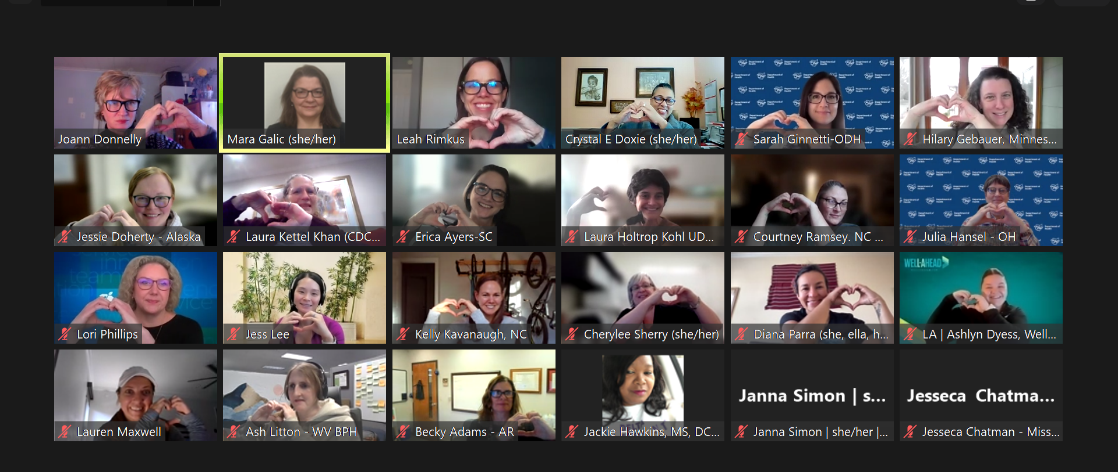
Building Resilient Inclusive Communities Family
November 14, 2023
Missing BRIC State Team Members: Margaret Chaykin (WA), Katie Reilly (AK), Lauren Kelsey (AK), Tiffany Bransteitter and team (PA), Dan French and team (NY), Kina White (MS), Sarah Young (MO), James Vance (WV) and Terri Jarvis (WV)

Slide 2
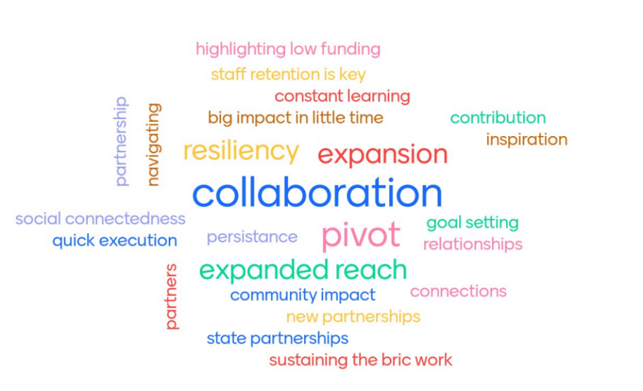

Slide 4
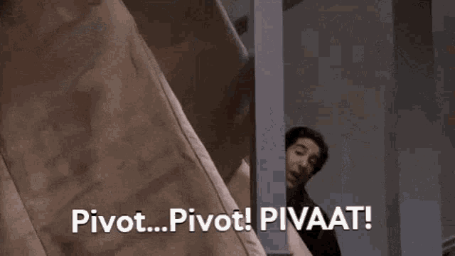
When in doubt…

