Slide 1
Inter-Tribal Council of Michigan
Increasing Colorectal Cancer Screening Among Tribal Members During the COVID-19 Pandemic
Notes:
The Inter-Tribal Council of Michigan, Inc. (ITCM) is a 501©(3) non-profit corporation duly organized under a State Charter filed April 16, 1968. The Inter-Tribal Council of Michigan, Inc. is located in Sault Ste. Marie, Michigan. It represents twelve federally recognized tribes in Michigan.
Mission Statement
To act as a forum for member tribes
To advocate for member tribes in the development of programs and policies which will improve the economy, education, and quality of life for Michigan’s Native Americans; and
To provide technical assistance to member tribes, assisting in the development of tribal regulations, ordinances, and policies applicable to health and human services.
The Inter-Tribal Council of Michigan (ITCM) is a dedicated advocate for reducing chronic disease and cancer disparities. Our programs support culturally appropriate education, training, policy and capacity building to support health equity among Michigan tribal communities.

Slide 2
The Disparity Among American Indian Populations
Native people in the state of Michigan are more likely than non-Hispanic White people to get lung, liver, kidney, and colorectal cancers
Compared to the general population, Cancer is diagnosed at younger ages and later stages among American Indian men and women in Michigan
Inadequate screening, lack of timely access to affordable care, and the unavailability of culturally appropriate treatment are some of the reasons why American Indians have higher rates of cancer

Slide 3
A Collaborative Forum to Improve Screening Rates
Analysis and Decision Making
Advocating for Program Development
Culturally Appropriate Community Engagement
Training and Technical Assistance

Slide 4
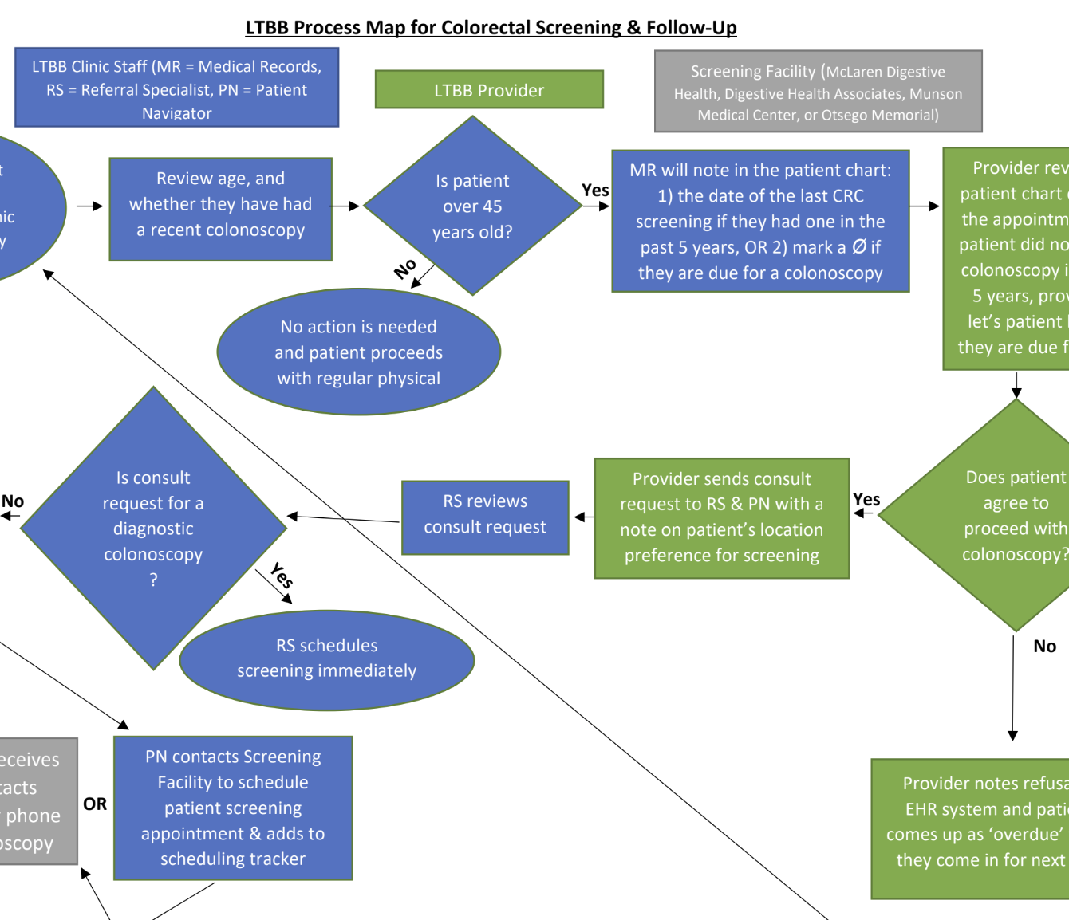
Following the Evidence
Multi-Component Interventions in Michigan Tribal Health Centers
Increasing Community Demand
– Client Reminders – Small Media – Social Media
Increasing Community Access
– Reducing Structural Barriers – Patient Navigation
Increase provider delivery of screening services
– Provider Reminders
Policy, Systems and Environmental Change
– Weekly Technical and Training Assistance – Screening Methods
Notes:
As highlighted by the Community Guide the Community Preventative Services Task Force recommends Multi-Component Interventions for increasing CRC screening Rates

Slide 5
CRC Program Highlights 2020 - 2022

Slide 6
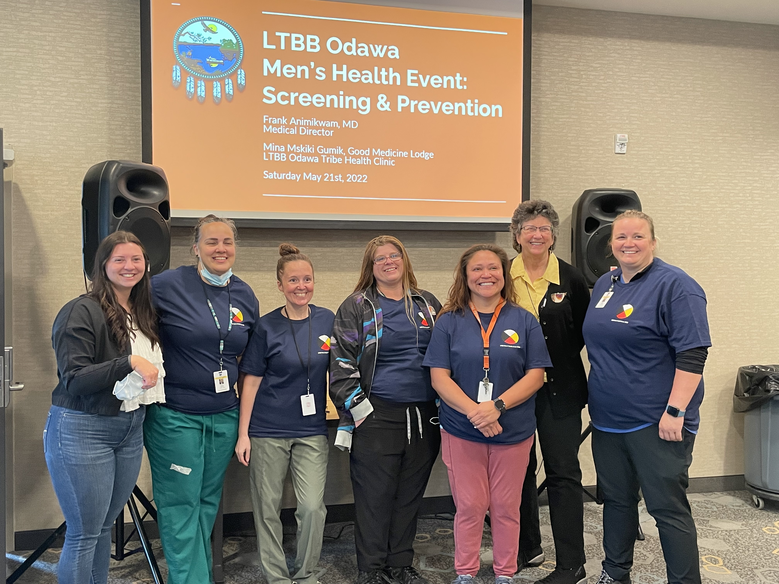
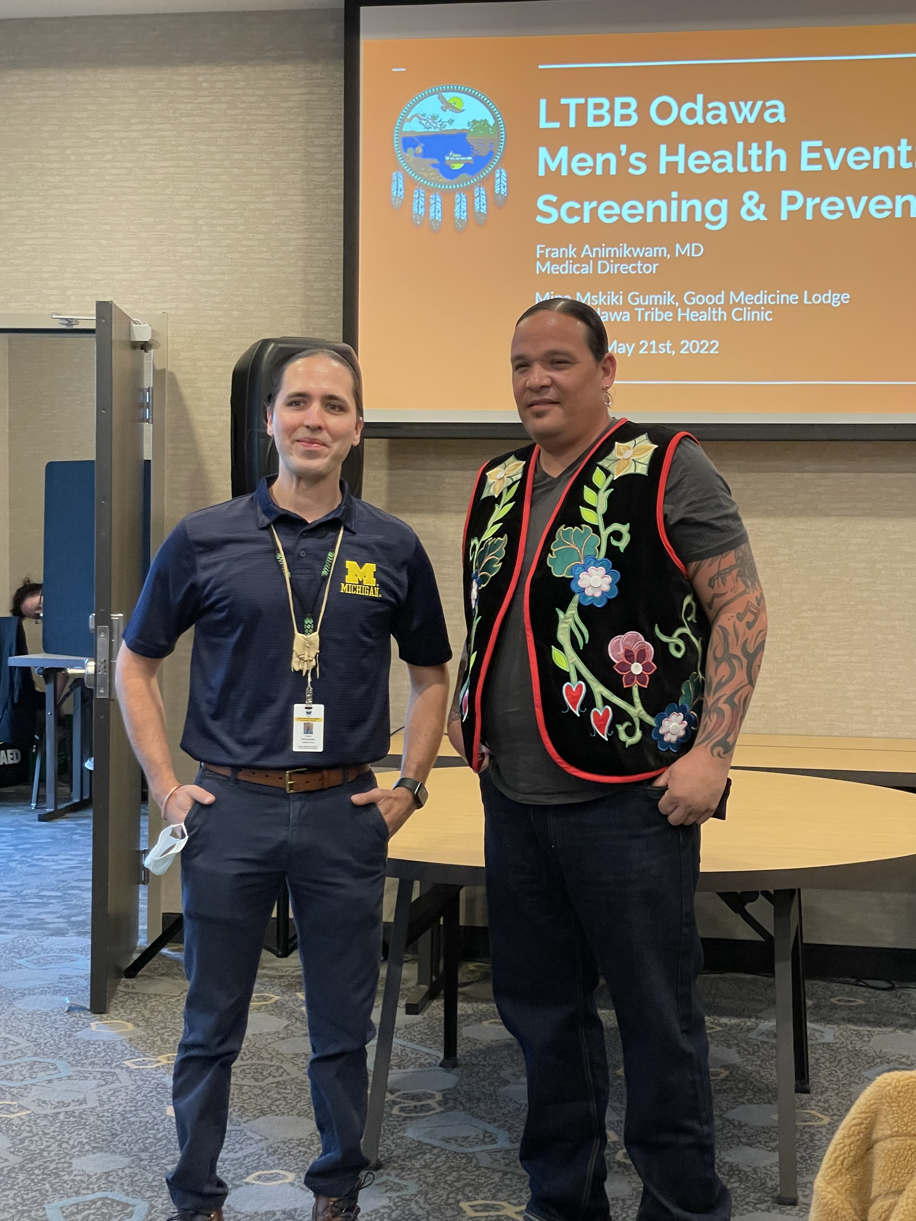
The Change Makers in Michigan

Slide 7
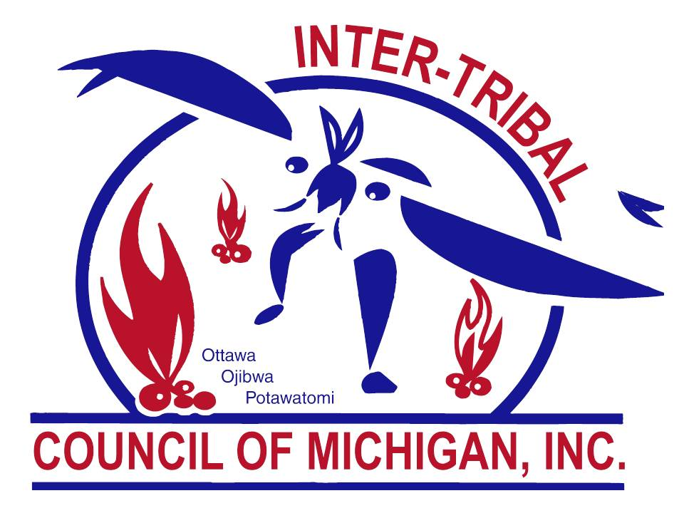
Where to Find Us
@InterTribalCouncilMichigan
@KweBrave
@intertribalcouncilmichigan
@kwebrave
https://www.itcmi.org/
E-mail: info@itcmi.org
Notes:
Finally, please feel free to share our resources available on Facebook, Instagram and our website. Kwe Brave is our breast cancer survivorship and educational page for American Indians.
If you need support please email us at info@itcmi.org

