Slide 1
RI Department of Health Colorectal Cancer Screening Program (CRCSP)

Slide 2
RI CRCSP Clinic Partnerships
The RI CRCSP partners with 7 FQHCs, 1 Native American organization (Narragansett Indian Health Center), and 2 safety-net (free) clinics
In total, these health systems comprise 27 individual clinic sites throughout Rhode Island with over 61,000 patients identified annually between the ages of 45-75yrs
Over the next 6 months, the RI CRCSP will begin a partnership with the RI Department of Corrections (RIDOC) to implement screening program activities within 4 housing facilities – Minimum, Medium, Maximum, and High Security

Slide 3
RI CRCSP Clinic Partnerships
Patient Navigators across all FQHC partners navigated:
13,186 patients in 2016*
15,734 patients in 2017
18,401 patients in 2018
17,554 patients in 2019
17,214 patients in 2020**
18,323 patients in 2021
*First full calendar year
**Split between 2 grant cycles

Slide 4
RI CRCSP Key Program Support Partnerships
Brown University School of Public Health – provides overall evaluation of program activities and outcomes
RI Health Center Association (RIHCA) – provides training, quality improvement projects, and assessment projects to partner clinics
Advocates for Human Potential, Inc. (AHP) – provides technical assistance to partner clinics to fully utilize their EMR/EHR and adjust their workflows to improve EBI implementation and patient care
Freedman HealthCare (FHC) - provides custom aggregated reports and analyses of Rhode Island’s All Payer Claims Database (APCD)

Slide 6
RI CRC Advisory Committee
27 members
14 organizations
- American Cancer Society - RI Hospital
- Blue Cross Blue Shield RI - RI Department of Health
- Care New England - RI Health Center Association
- Coastal Medical - Roger Williams Medical Center
- Gastroenterology Associates - University Gastroenterology
- Miriam Hospital - Women & Infants Hospital
- Partnership to Reduce Cancer in RI - YWCA RI

Slide 7
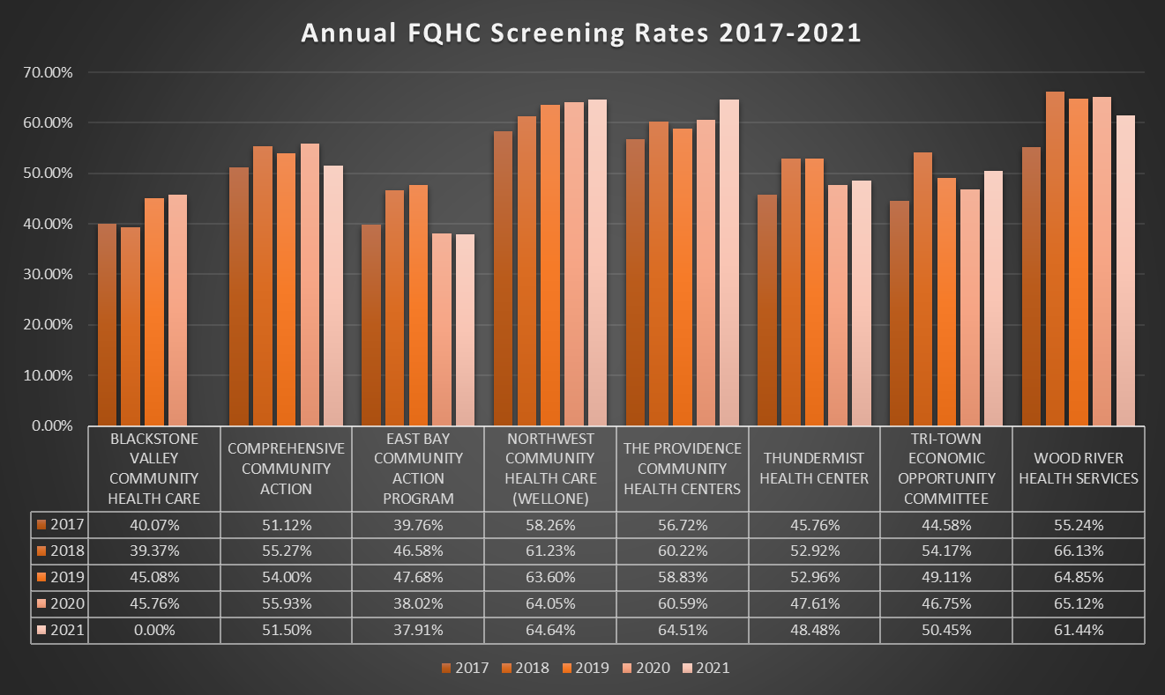

Slide 9
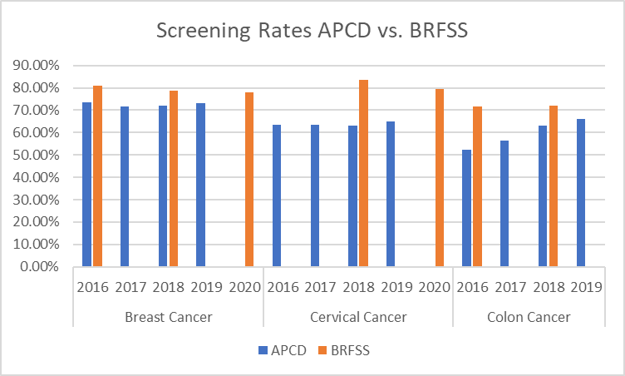
Source |  | APCD | BRFSS
Breast Cancer | 2016 | 73.45% | 80.90%
 | 2017 | 71.54%
 | 2018 | 71.96% | 78.80%
 | 2019 | 73.24%
 | 2020 |  | 77.90%
Cervical Cancer | 2016 | 63.55%
 | 2017 | 63.35%
 | 2018 | 63.12% | 83.40%
 | 2019 | 65.05%
 | 2020 |  | 79.30%
Colon Cancer | 2016 | 52.46% | 71.50%
 | 2017 | 56.29%
 | 2018 | 62.98% | 72.20%
 | 2019 | 66.06%

