Slide 1
Minnesota Sage Patient Navigation Center

Slide 2
Sage Programs
Sage – Breast and Cervical Cancer Screening
Sage Scopes – Colorectal Cancer – health systems
SagePlus – Cardiovascular Health
Referral Programs – Pre-diabetes, Tobacco Cessation, MNsure insurance exchange

Slide 3
WHO ARE WE?
A diverse group of women trained in motivational interviewing that speak multiple languages and have many years of experience working with Minnesota’s underserved populations. Sage’s navigation center currently represents the Latino, African American, Vietnamese, and Hmong communities.

Slide 4
Navigation Center Facts and Purpose
Established in 1996
The longest standing patient navigation center amongst the national breast and cervical cancer programs.
Reduce structural barriers to healthcare, i.e., transportation, culture/language, insurance status, etc.
Call clinics using a three-way call with our patients when scheduling appointments. Schedule 1/3 of all Sage patient appointments.
Partner with nearly 500 clinics across the state and connect patients to other needed resources as well.

Slide 6
WHAT DO NAVIGATORS DO
PLACE AND RECEIVE CALLS
Incoming calls: average about 9,000 annually
Outgoing calls: average over 10,000 annually
CONDUCT PATIENT FOLLOW-UP
Follow-up calls, up to five calls for each patient
Reminder calls to patients that are due for screening

Slide 7
WHAT DO NAVIGATORS DO
Screening and mobile mammography events
Assist community and clinic partners in coordination and implementation of screening and mobile mammography events.
Prior to screening event navigators:
Coordinate logistics with partner clinics, community site hosts
Create fliers for event, prepare forms
Recruit patients, mailing and calling, scheduling patients

Slide 8
WHAT DO NAVIGATORS DO
Day of screening event:
Attend and navigate patients through enrollment and screening
Post screening event:
Enter completed form data into Sage’s database
Schedule F/U appointments with patients if needed

Slide 9
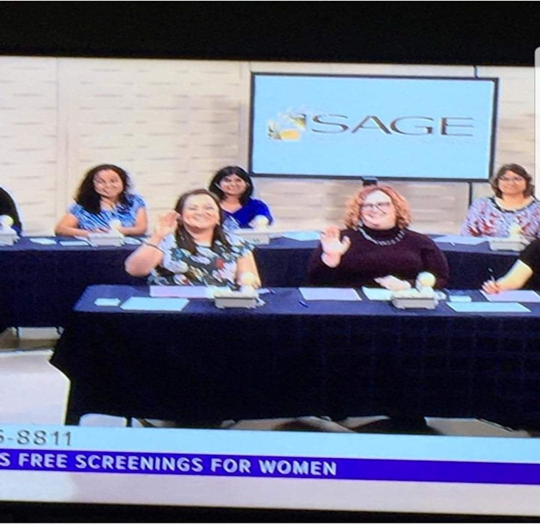
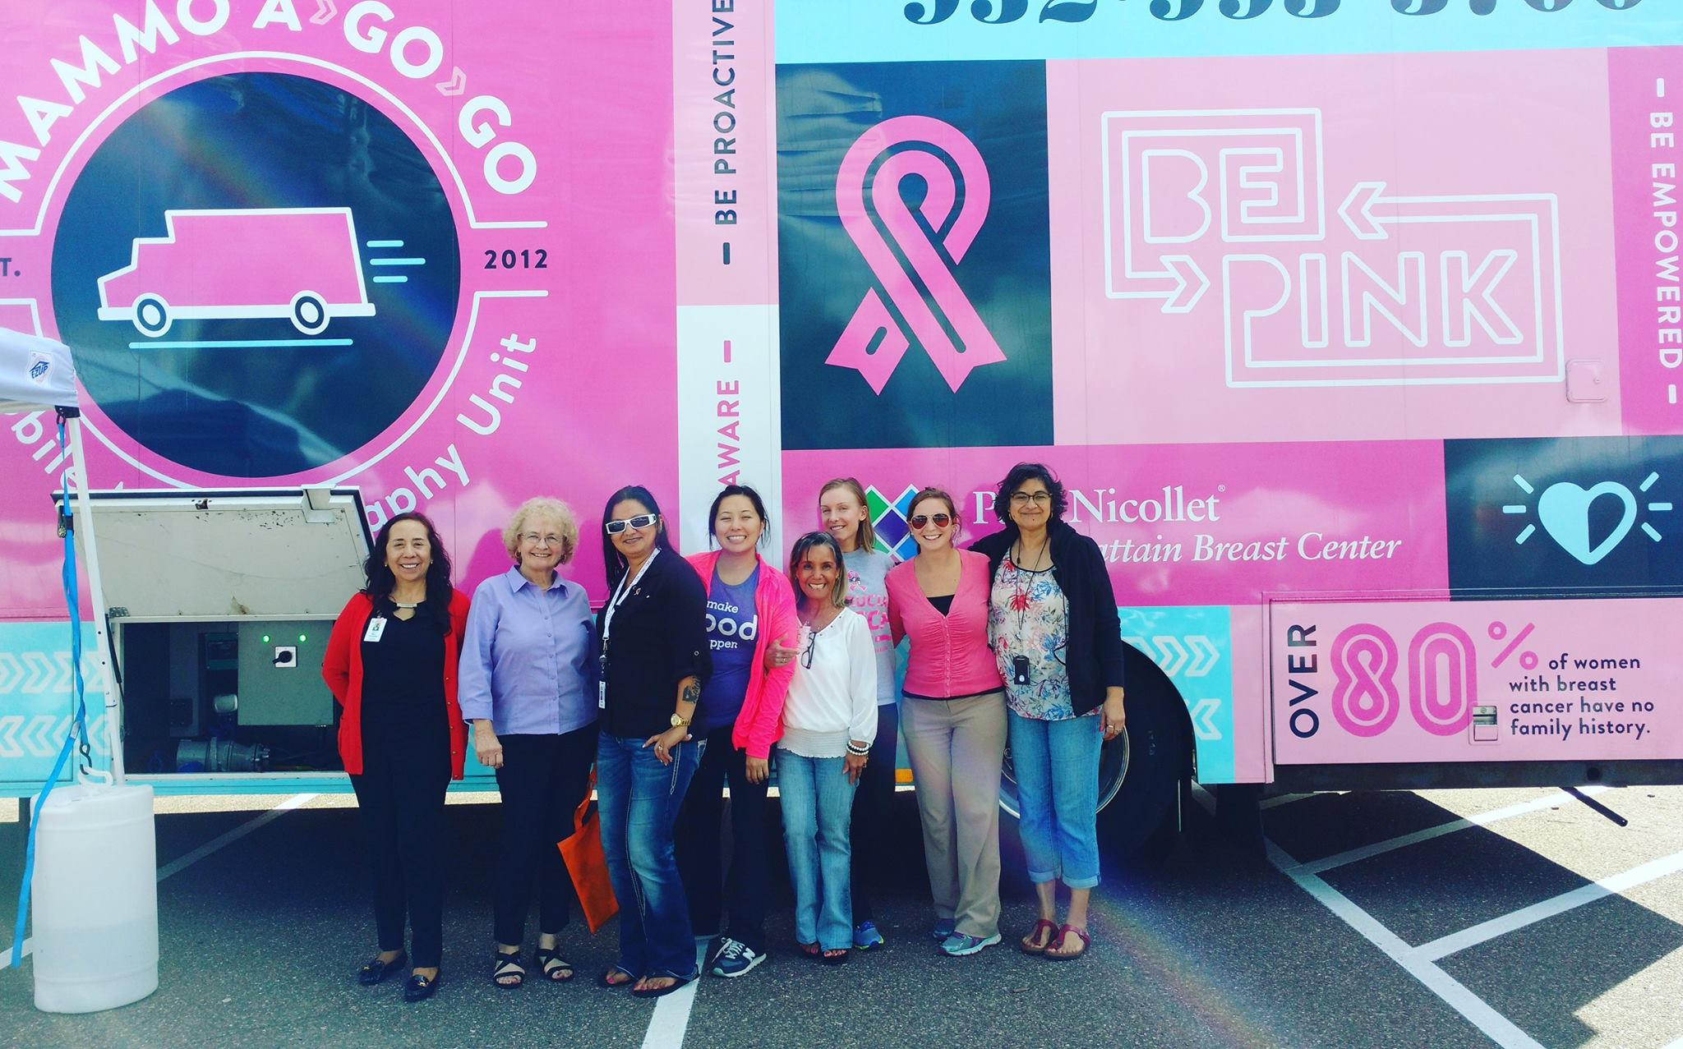
Mobile Screening Event

Slide 10
WHAT DO NAVIGATORS DO
Refer patients/callers to other health programs:
WISEWOMAN (SagePlus), Sage Scopes, Tobacco, MNSure, Diabetes
Mail monthly letters to patients:
Reminder, MNSure, Tobacco
Average 800 mail pieces monthly

Slide 11
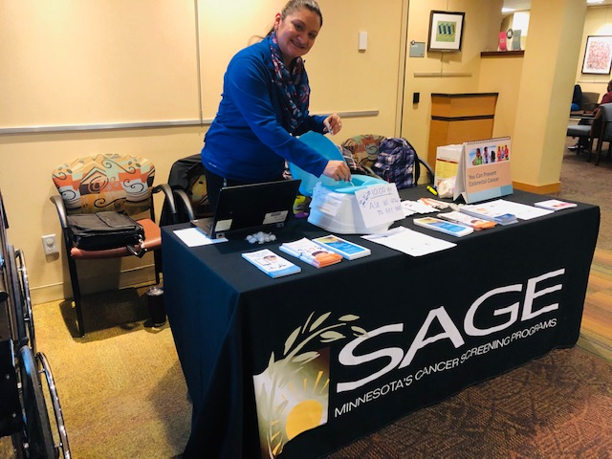
Sage navigators at events

Slide 12
Thank you.

