Slide 1
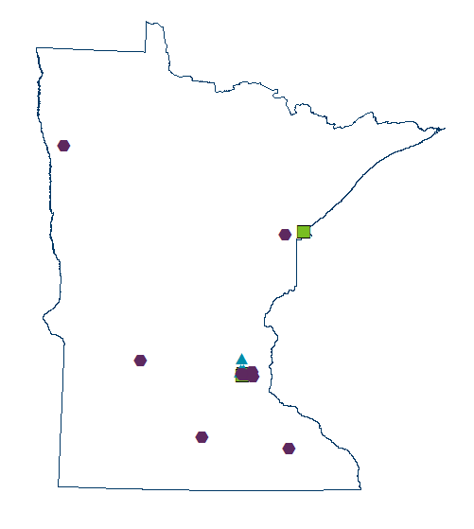
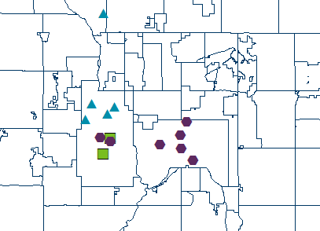
MN Sage & Scopes Systems Change
Program Map August 2021
Minneapolis & St. Paul
Operating
Recruiting
Future recruit

