Slide 1
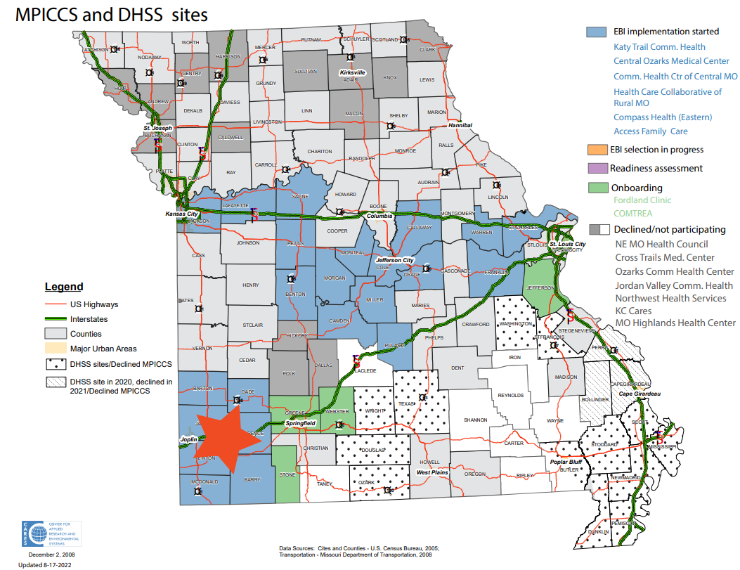
Presenter’s name: Role/Title:
Number of current clinics:
What are your EBIs?
Staff (number of staff): RNs, LPNs, MAs, MDs, PNs, CHWs, CNAs, techs, desk staff, Volunteers, etc.

Slide 2
Staff duty change/turnover
c-suite
care providers
support staff
EBI Role(s)
Notes:
Please circle who’s leaving. C-Suite refers to leadership, care providers refers to clinical staff.
EBI Roles: Add notes for who these people are and their roles in EBI

Slide 3
Consequences of turnover/reassignment on CRC screening?
Prompts:
How, if at all, has this affected your clinic’s approach?
In which phase? Implementation, data tracking, EHR usage, etc.?
Notes:
Has this affected your clinic: tell us how this has affected your CRC screening and/or your clinic environment overall.

Slide 4
How are you overcoming these challenges?
Prompts:
What’s your ‘plan B’?
Who’s taking over the void?
How’s it working out?

