Slide 1
Colorectal Cancer Learning Collaborative
Missouri Partnerships to Increase Colorectal Cancer Screening Rates in Clinical Settings (MPICCS)
Jean Wang, M.D., Ph.D.
Division of Gastroenterology
Washington University / Barnes-Jewish Hospital

Slide 2
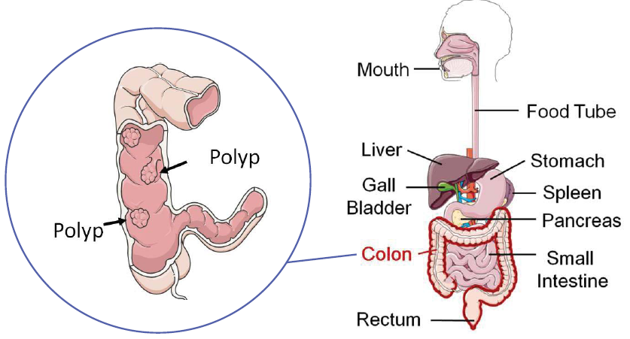
Where is the Colon and Rectum?

Slide 3
Colorectal Cancer is the
3rd Most Common Cancer in the U.S.

Slide 4
What’s Your Chance of Getting Colorectal Cancer?
1 out of 20 people will get colon cancer at some point during their lifetime
Major Risk Factors
  Increasing age
  Family history or personal history of colon cancer or precancerous polyps (adenomas)
  Inflammatory bowel disease (Crohn’s disease or ulcerative colitis)
  African-American race
  Obesity
Notes:
major risk factors for CRC that are potentially
modifiable include physical inactivity, being overweight
and obese, and a diet high in red and processed
meats

Slide 5
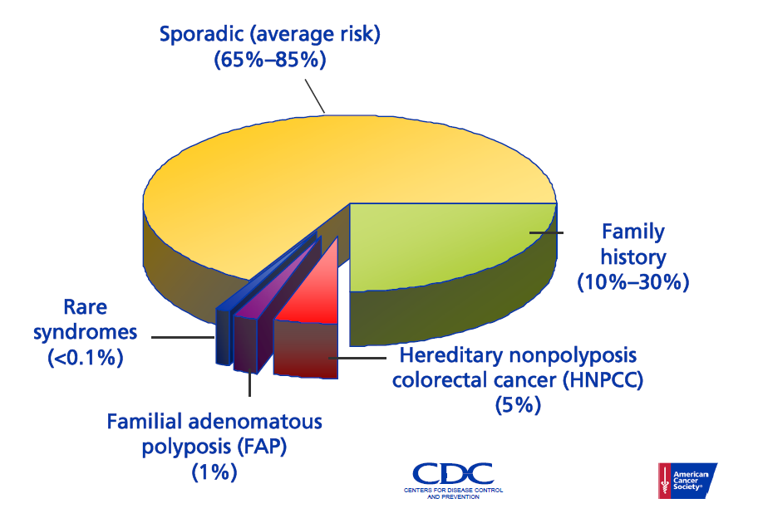
What Kind of People Get Colorectal Cancer?
No family history

Slide 6
Symptoms of Colorectal Cancer
Rectal bleeding
Blood in the stool
Anemia (low blood count)
Weight loss (unintentional)
Persistent abdominal pain
If you have any of these symptoms, you should get a colonoscopy for evaluation

Slide 7
Best way to prevent colorectal cancer SCREENING!

Slide 8
Why is Screening so Important?
Screening tests can help find cancer at an early stage, before symptoms appear.
When precancerous growths or cancer are found early, it may be easier to treat or cure.
By the time symptoms appear, the cancer may have grown and spread. This can make the cancer harder to treat or cure.

Slide 9
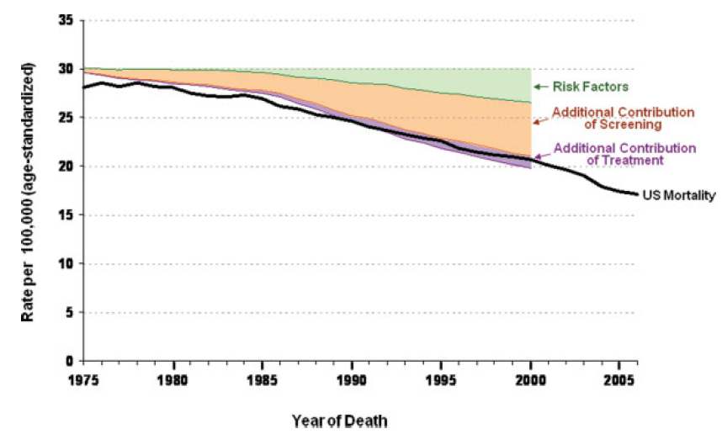
Colorectal Cancer Mortality
35%
53%
12%
Edwards BK, et al. Cancer 2010;116:544-73.
Notes:
The model predicted
that, with only changes in risk factors, CRC mortality
would decrease by 9%, explaining 35% of the observed
mortality decline. Screening decreased mortality by
another 14%, explaining 53% of the mortality reduction,
whereas treatment added another 3% decline, explaining
the final12%of the observed decline inCRCmortality.

Slide 10
Colorectal Cancer Develops from Some Types of Polyps

Slide 11
Types of Polyps
Hyperplastic
  Harmless
Adenomas
  Precancerous – not cancer, but if not removed it can keep growing and eventually turn into cancer (takes about 10 years)

Slide 12
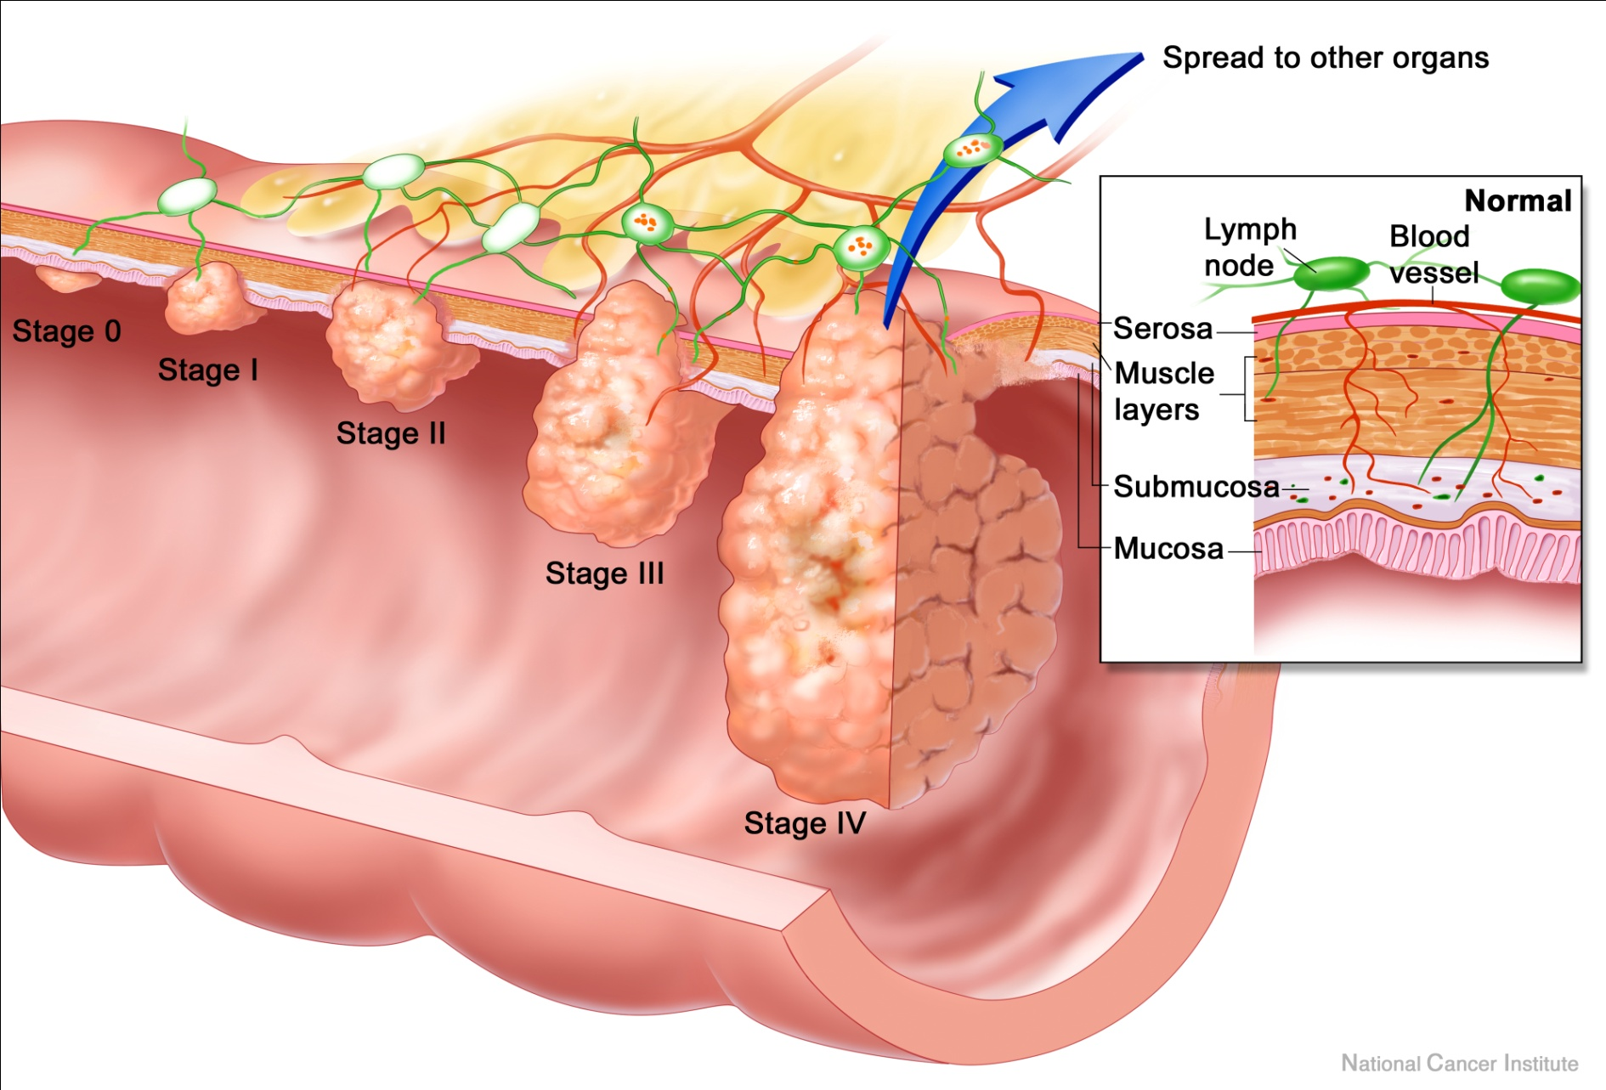
From Polyp to Colon Cancer

Slide 13
Early Detection Saves Lives

Slide 14
Colorectal Cancer is Preventable
75% of colorectal cancer is PREVENTABLE!
Of all the types of cancer, colorectal cancer is one of the most preventable and curable.

Slide 15

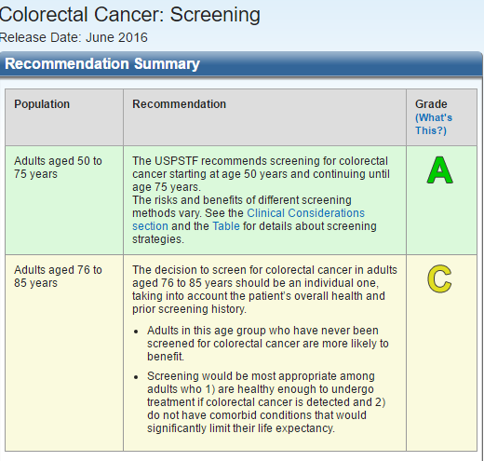

Slide 16
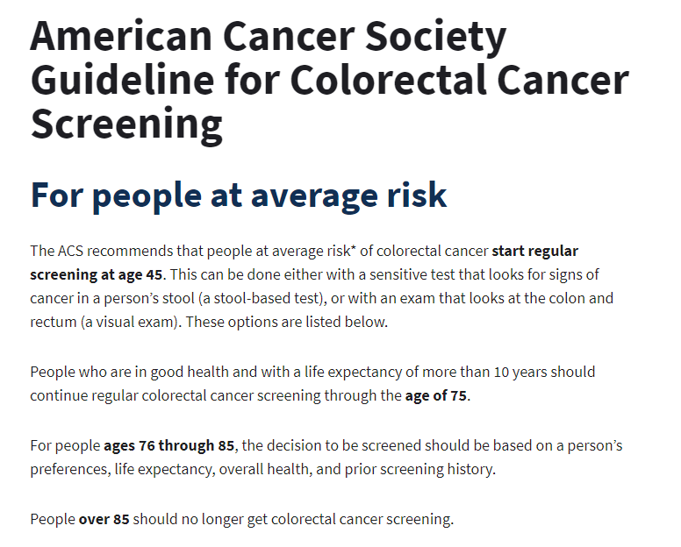

Slide 17
Colon Cancer Screening Options
Choose One (for People with No Family History of Colon Cancer)
MOST COMMON
Colonoscopy - every 10 years
Stool tests
  Detect blood (FOBT, FIT) – every year
  Detect blood + abnormal DNA (Cologuard) – every 3 years
LESS COMMON
CT colonography (“virtual colonoscopy”) – every 5 years
Flexible sigmoidoscopy – every 5 years

Slide 18
Family History of Colon Cancer
If you have a first-degree relative with colon or rectal cancer (parent, sibling, child)
  Chance of getting colon cancer is 2-4 times higher than someone without a family history
    But nearly completely preventable!
  Recommend colonoscopy every 5 years
  Other screening tests are not options

Slide 19
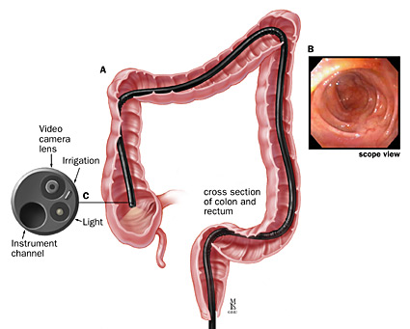
Colonoscopy

Slide 20
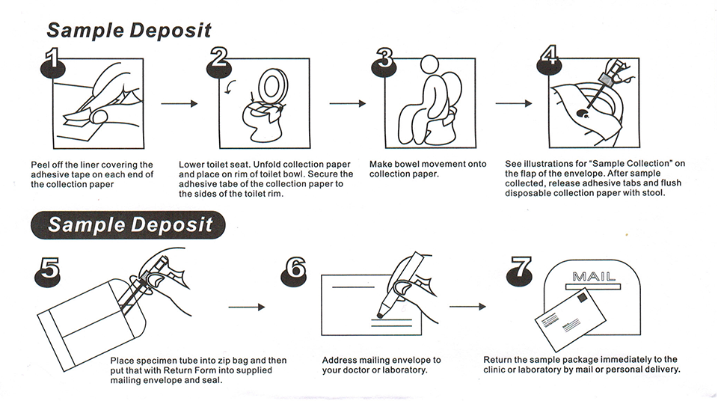
Stool testing
(to detect traces of blood)

Slide 21


Stool tests
FOBT
(Fecal Occult Blood Test)
FIT - better
(Fecal Immunochemical Test)

Slide 22
Cologuard Stool DNA Test

Slide 23
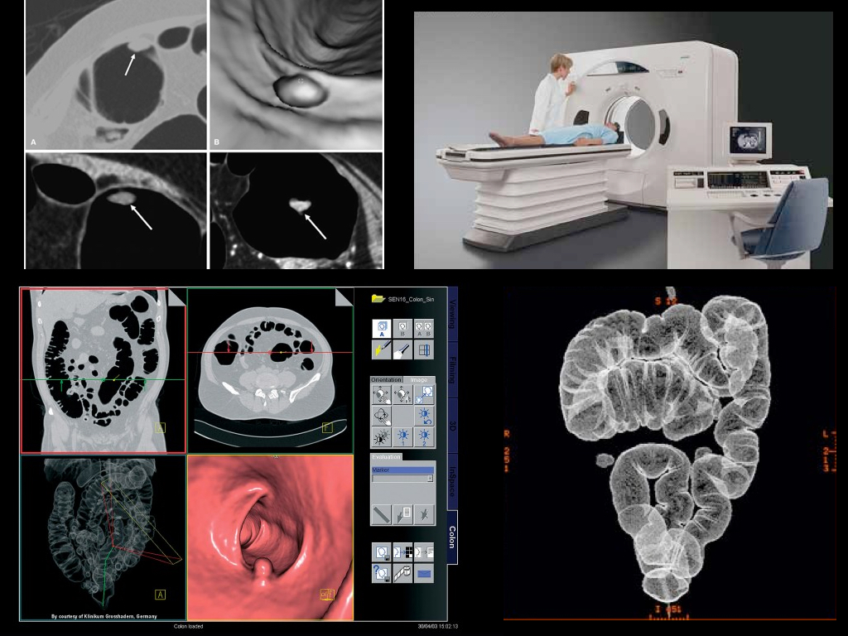
CT Colonography

Slide 24
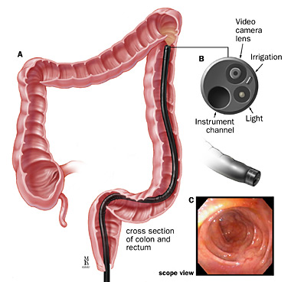
Flexible Sigmoidoscopy

Slide 25
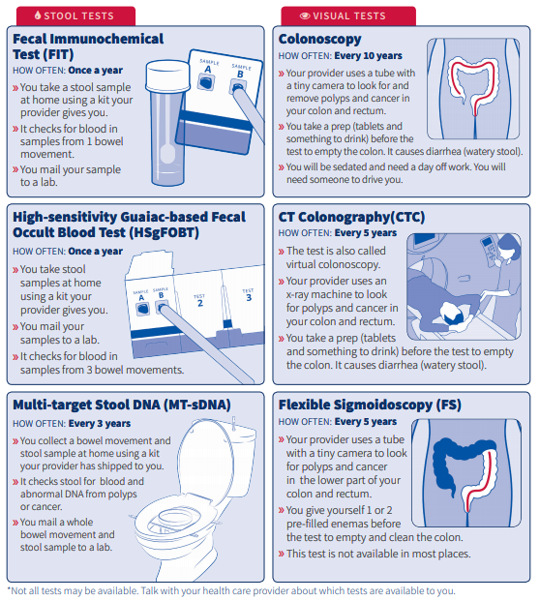
Notes:
Another point of emphasis of the guideline is the importance of options.
Making sure that patients are aware that there are multiple screening options for colorectal cancer, including stool based tests- fecal immunochemical tests or high sensitivity guaiac tests, along with multi-target stool-DNA testing.
In addition there are structural exams, visual exams which are more invasive exams.
Those include colonoscopy, CT colonography, which is sometimes referred to as virtual colonoscopy, and flexible sigmoidoscopy.
There is evidence supporting the use of all of these tests for colorectal cancer screening and all have demonstrated potential positive outcomes.
So, any of these that are available to you and your patients is a reasonable approach to colorectal cancer screening, so long as they are utilized at the intervals as defined and performed in a high quality manner.

Slide 26
The best test is the one which gets done!
Any abnormal test needs to be followed-up with a colonoscopy.

Slide 27
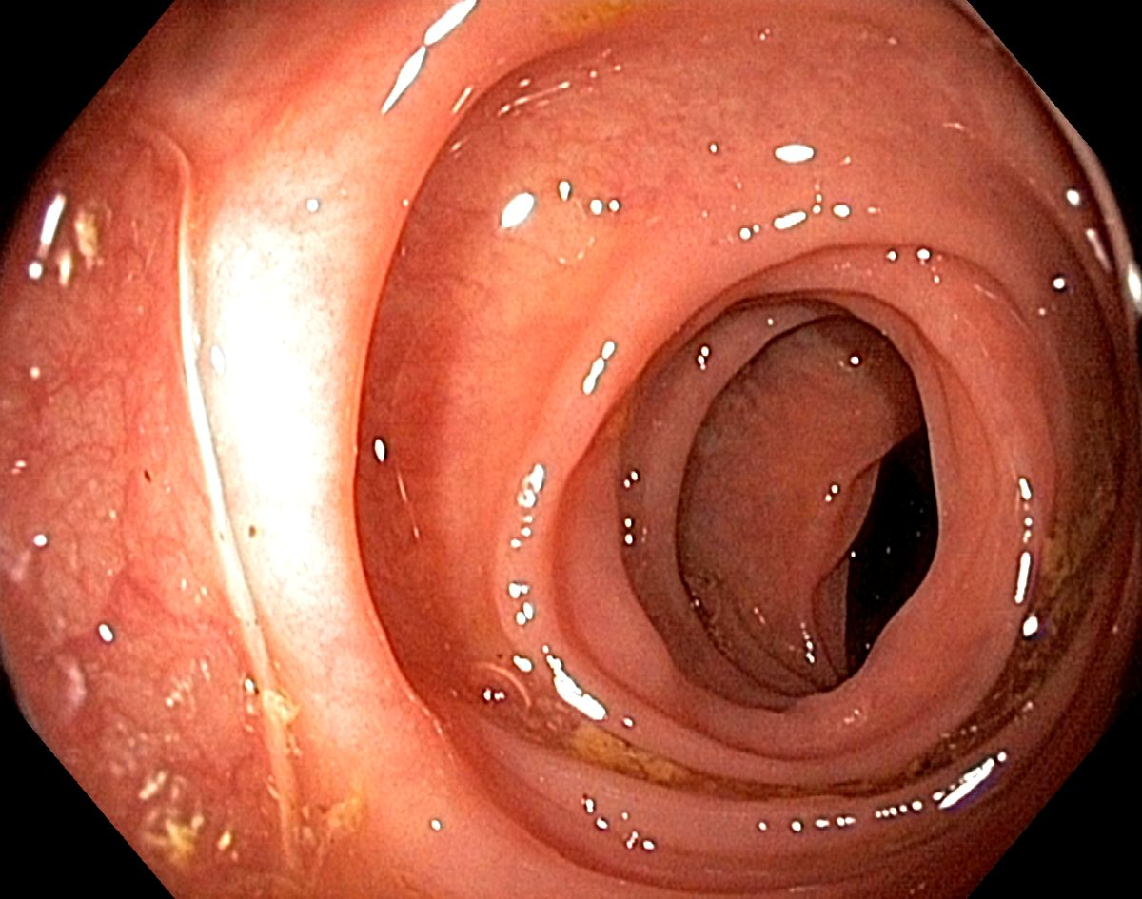
What does a normal colon look like?

Slide 28
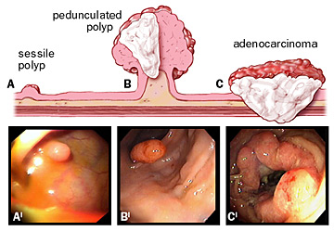
What do polyps/cancer look like?

Slide 29
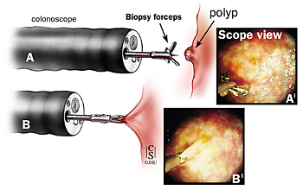
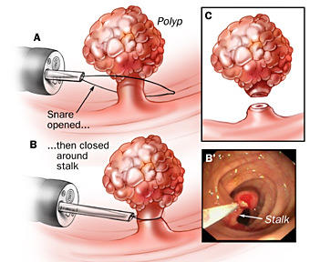
How are Polyps Removed?

Slide 30
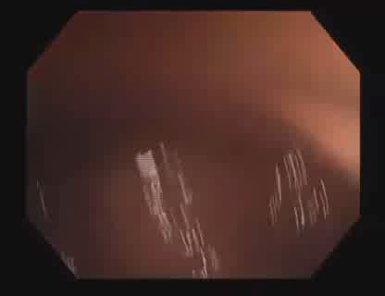
Colonoscopy Video
American College of Gastroenterology
Notes:
http://www.youtube.com/watch?v=ewCIqAAJGPg

Slide 31
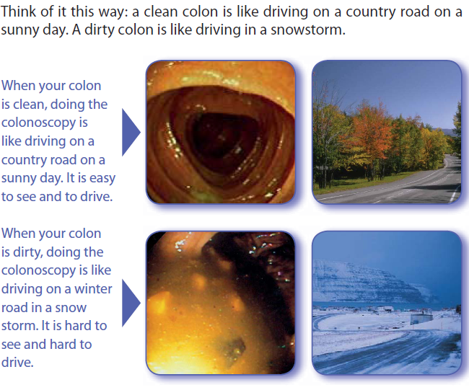
Importance of Bowel Preparation
Spiegel BMR et al, Am J Gastro 2011: 106:875-883

Slide 32


86.6 million adults age 50-75
58.3 million (67.3%) Up-to-Date
22.2 million (25.7%) Never Screened
Joseph, D.A. (2019, January 28). Colorectal Cancer Screening Data Set Update: How Are We Doing On Our Efforts To Reach 80%? [Webinar].

Slide 33
Common Patient Excuses for Not Screening
I don’t have symptoms
No one in my family has had colon cancer
I don’t have time
I don’t have anyone to take me for a colonoscopy
The bowel preparation is uncomfortable
I’m scared to have the test done
I’m afraid I’ll get COVID
If I have cancer, I’d rather not know / there’s nothing that could be done about it.

