Slide 1

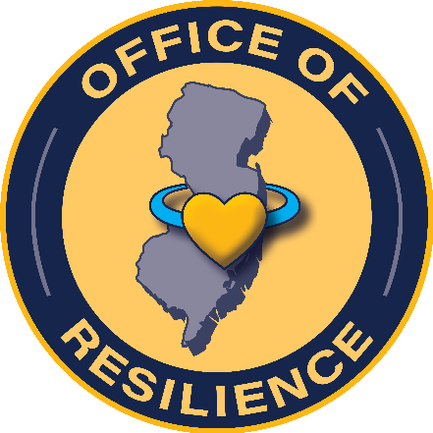

State Actions to Address ACES
National Association of Chronic Disease Directors

Slide 2




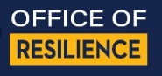
Emergent NEAR Science Education before the NJ ACES Action Plan

Slide 3
Community Capacity Development
Leadership Expansion
Coming Together
Shared Learning
Results-Oriented Decisions
Notes:
Each successful community has traveled that journey differently – because each community is unique. But communities that have reduced major social problems, reduced the percent of young people with high ACE scores, and improved key factors for resilience do use similar processes for achieving better results. They use these processes to work over time to build new capacities for helping one another to thrive and new capacities for aligning resources and systems so they achieve better results.
In Washington State, a system of Community Public Health and Safety Networks call these communities “high capacity communities”. The process they have used since 1994 is called general community capacity development. It’s a public health approach to solving interrelated problems by improving peoples’ connections, their shared responsibility, and the collective impact of their efforts.
Community Capacity Development puts into place a four-phased iterative process to nurture development of healthy and productive adults regardless of the circumstances into which they are born. It is an approach that invites all members of the community to shift the ways we engage with one another on a day to day basis, improving peoples’ connections, shared responsibility, skills and efficacy.
This approach increases the collective impact of services and neighborhood initiatives by aligning efforts around common purpose. The four phases in the process are: leadership expansion, coming together around issues of importance to the community, learning together, and results-based decision making. The process is powerful because success in one phase propels success in the next. It generates a virtuous cycle with the power to improve population health, and uses all the resources in a community including its “people power”.

Slide 4





5 CORE STRATEGIES
CORE STRATEGY 1
CORE STRATEGY 2
CORE STRATEGY 3
CORE STRATEGY 4
CORE STRATEGY 5
Achieve Trauma-Informed and Healing-Centered State Designation
Conduct an ACEs Public Awareness and Mobilization Campaign
Maintain Community-Driven Policy and Funding Priorities
Provide Cross-Sector ACEs Training
Promote Trauma-Informed/Healing-Centered Services and Supports

Slide 5


NEAR Science Education and activity branching/ arborization in process (after the NJ ACEs Action plan was released)
ACE Interface
.P
.P
.T
.T
.P
.P
.T
OOR
.P
.LH
.T
.T
.LH
.P
.P
.P
.T
.T
.P
.LH
.T
.T
.P
.P
LH = License Holders
T = Trainer
P = Presenter
= Community Individuals
and Organizations
.T
.P
.T
.T
.LH
.P
.T
.P

Slide 6
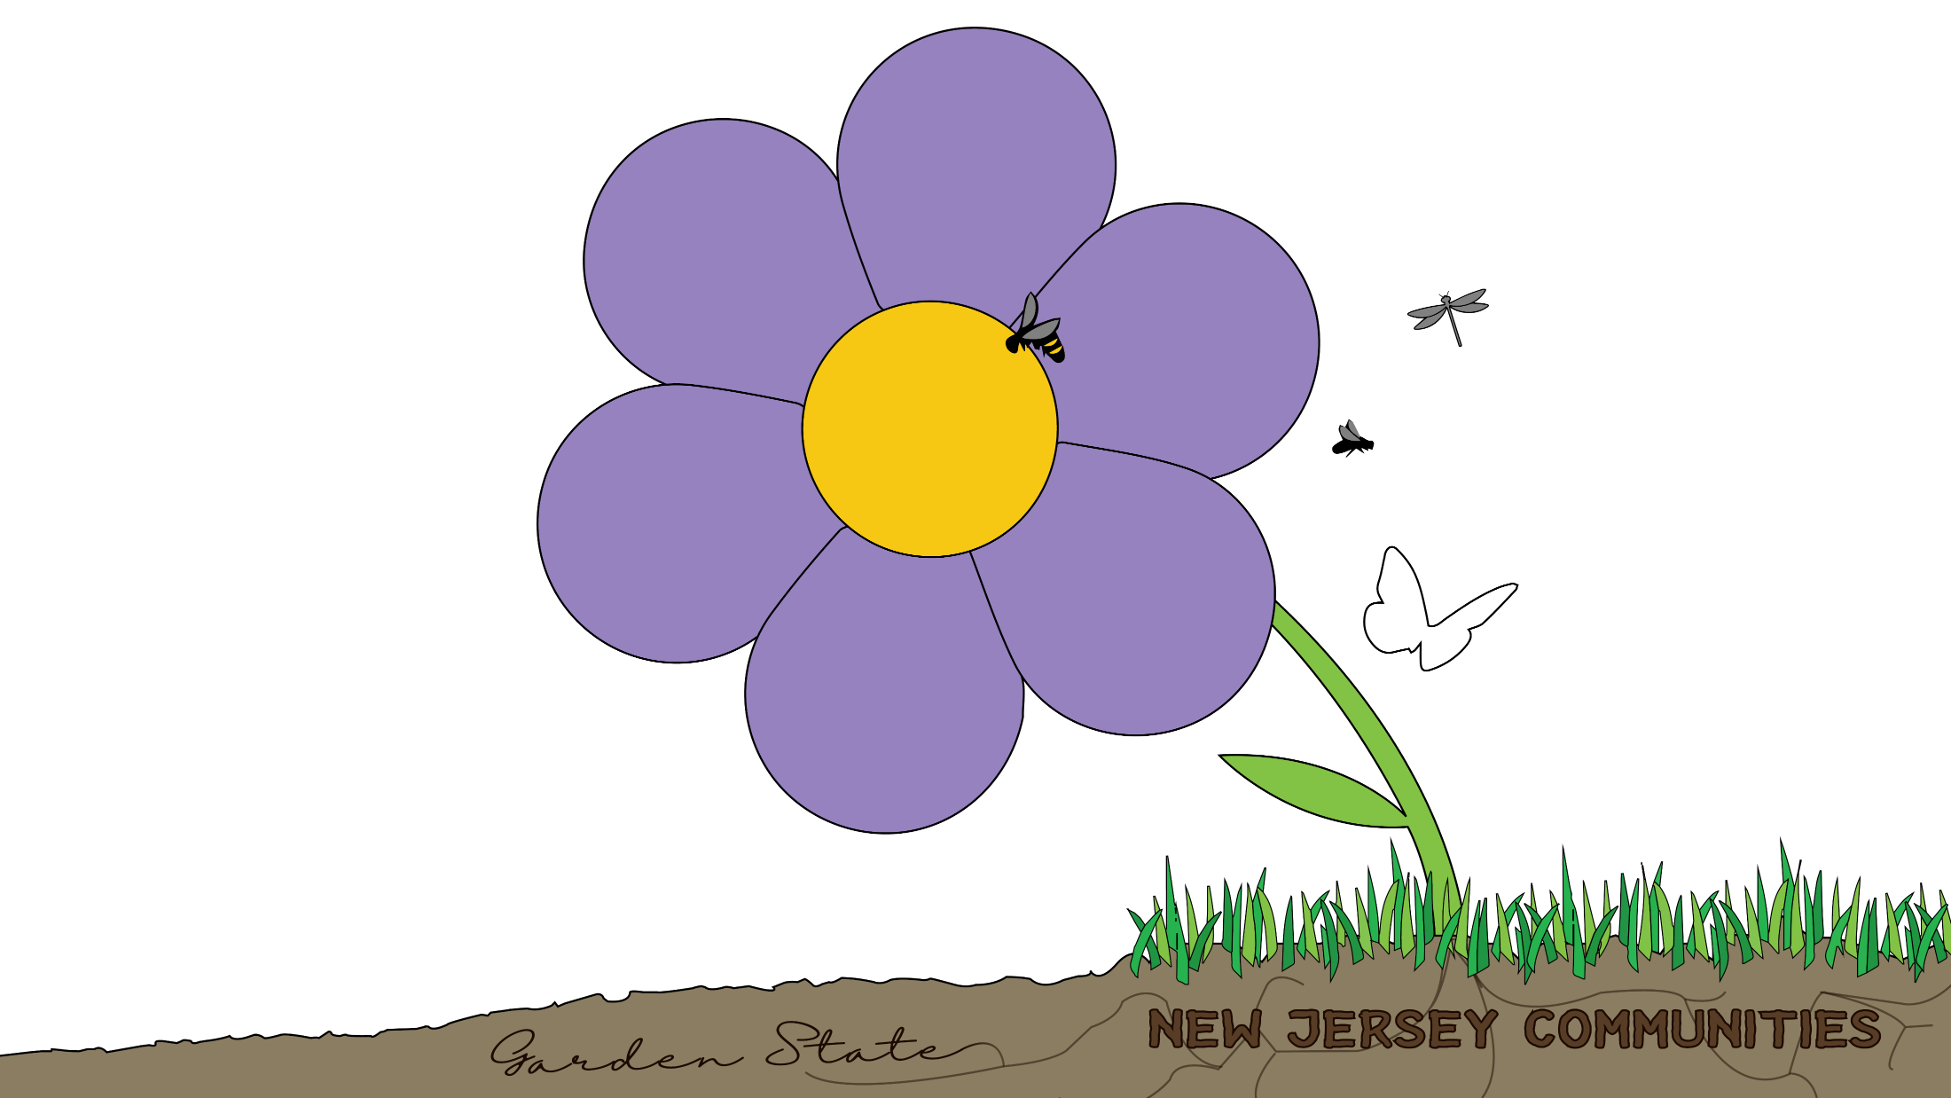
Healing NJ Together (HNJT) now, a flower from the OOR greenhouse.
pollinators
OOR staff
Future seeds led by community
ACEs Interface presenters and trainers
Partners
VISION: To engage New Jersey Communities to imagine and co-create healing, supportive, thriving futures.

Slide 7
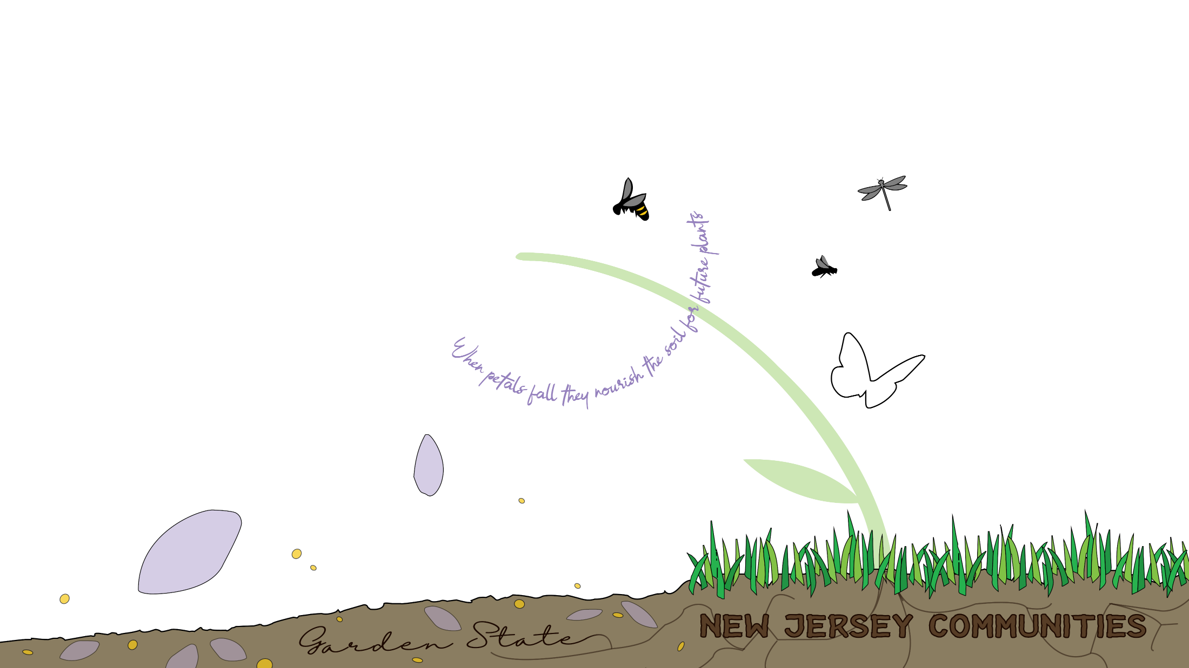
HNJT now,
a flower from
the OOR greenhouse.
pollinators
OOR staff
ACEs Interface presenters and trainers
Partners
Future seeds led by community

Slide 8
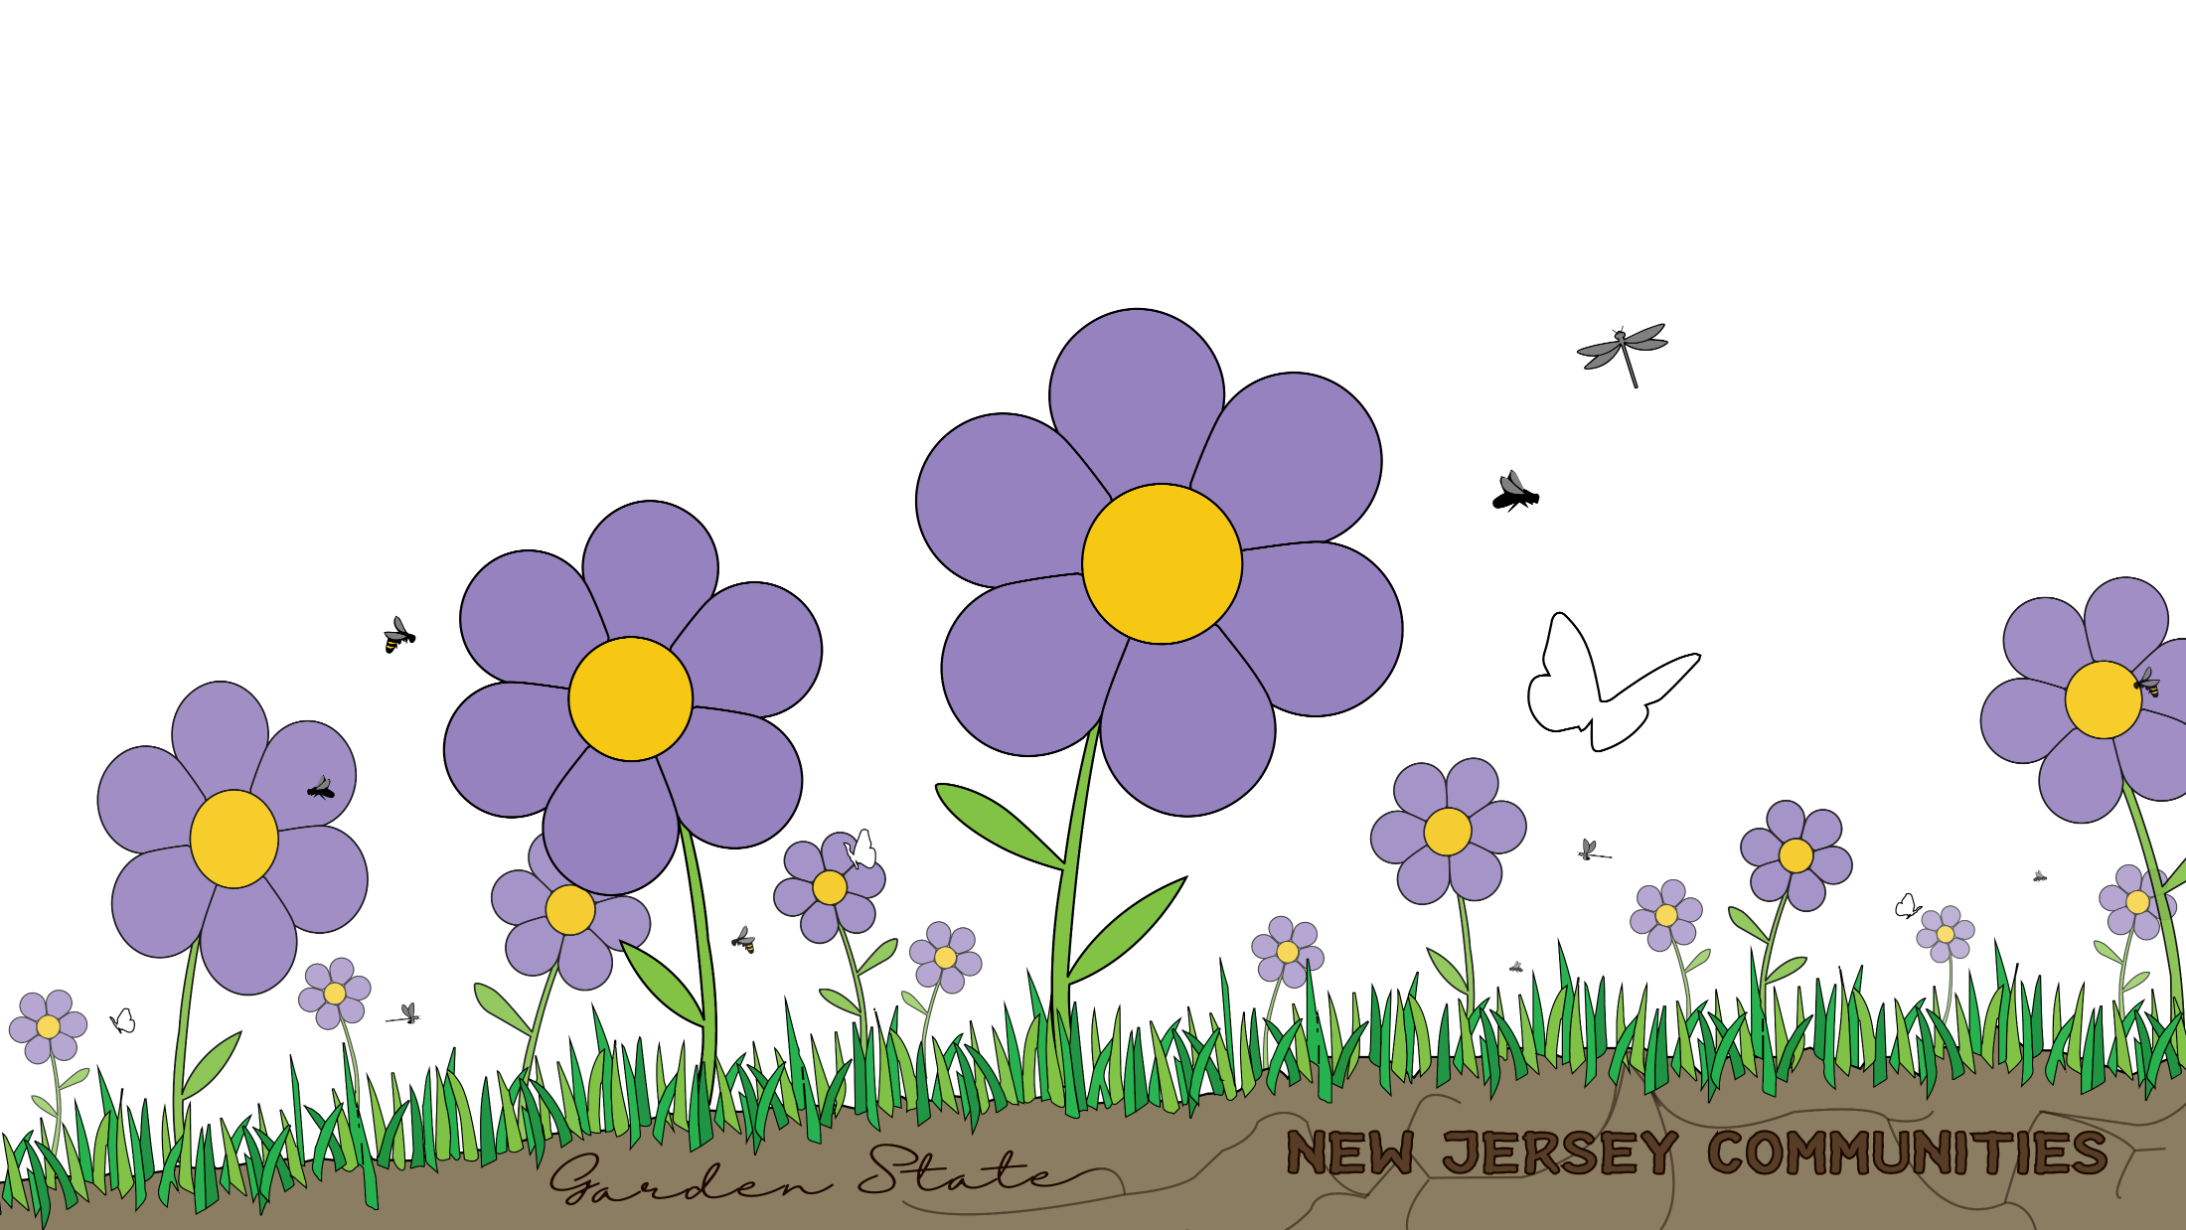
HNJT now,
a flower from
the OOR greenhouse.
pollinators
OOR staff
ACEs Interface presenters and trainers
Partners

Slide 9

Dave Ellis, Executive Director
OFFICE OF RESILIENCE
NJ Department of Children and Families
“New Jersey is a leader across the nation in identifying ACEs as a public health crisis in need of attention and intervention. It’s only through awareness that we can begin to heal and build resilience in our communities. I’m thankful for the breadth of partners we have committed to the hard, heart work ahead of us.”

Slide 10
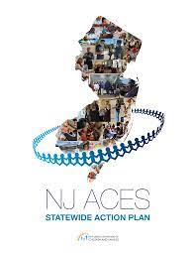
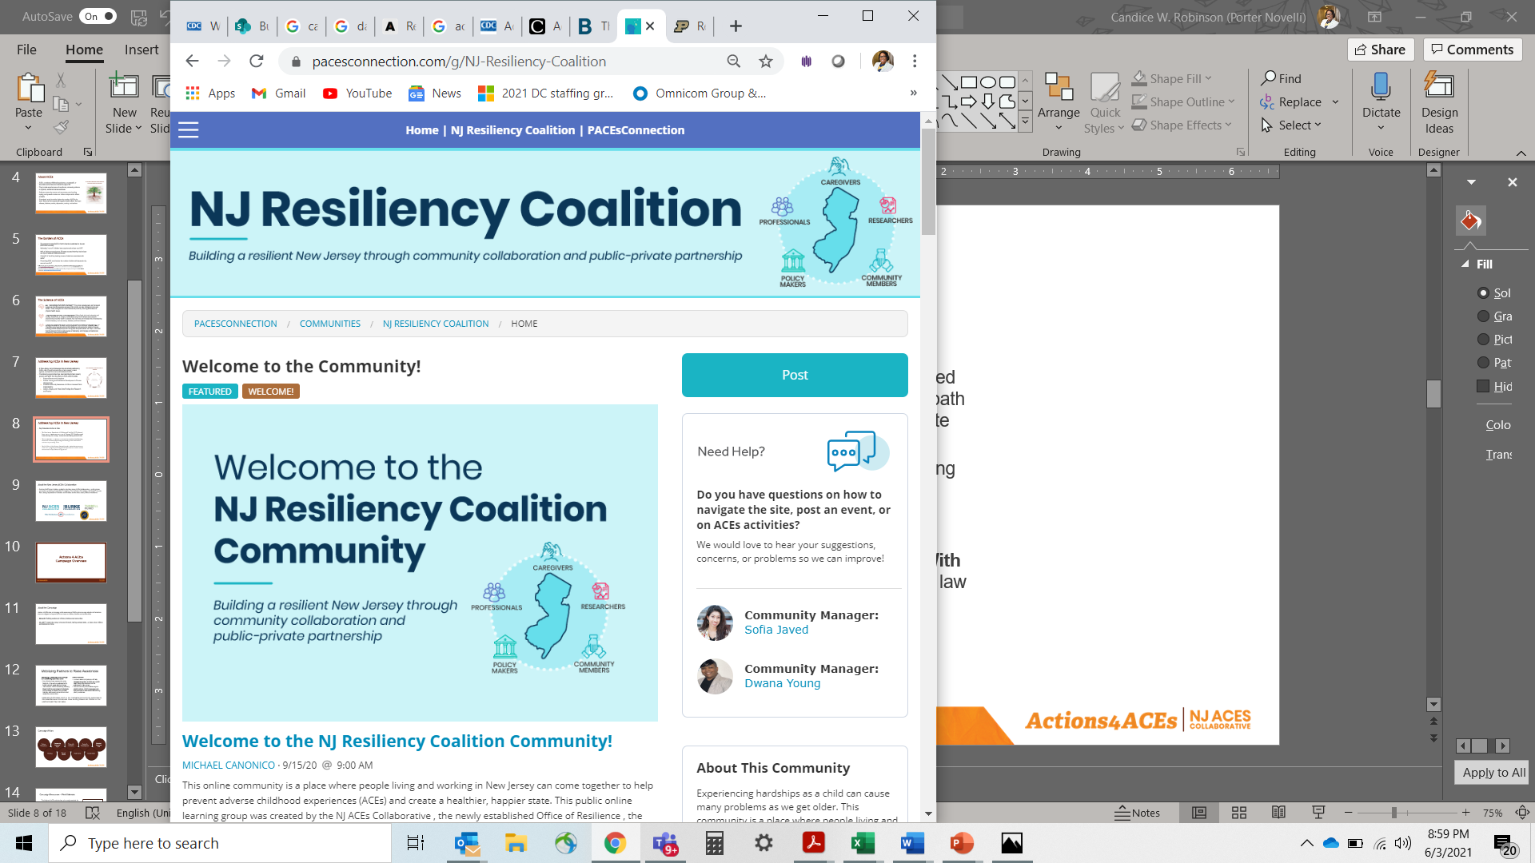
Addressing ACEs in New Jersey
Key Statewide Activities to Date
  The New Jersey Department of Children and Families (DCF) released the NJ ACEs Statewide Action Plan in February 2021 detailing a path toward making New Jersey a trauma-informed/healing centered state
  The NJ ACEs Collaborative created the NJ Resiliency Coalition Community as an active virtual learning center that convenes people living and working in the state around solutions for preventing ACEs
  The NJ Office of the Attorney General issued a statewide Handle With Care (HWC) program promoting partnerships between schools and law enforcement to help children facing trauma

Slide 11





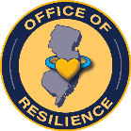
Addressing ACEs in New Jersey
The Actions 4 ACEs campaign is an initiative guided by the New Jersey ACEs Collaborative,
a public-private partnership consisting of
The Burke Foundation, The Nicholson Foundation, The Turrell Fund, The New Jersey Department of Children and Families and
The New Jersey Office of Resilience

Slide 12

About the Campaign
Actions 4 ACEs aims to increase public awareness of ACEs and encourage adoption of behaviors that can mitigate the impact ACEs can have on children, families and communities
MISSION: Building resilience in children, families and communities
VISION: To make New Jersey a trauma-informed, healing-centered state – a place where children and families can thrive
INITIAL AUDIENCE: Community, law enforcement and education professionals (serving grades Pre-K through 12)

Slide 13

Goals and Objectives
By campaign end, educators and law enforcement officers in New Jersey will report having increased:
Knowledge of ACEs, including causes, prevalence and impact
Understanding of the benefits of addressing ACEs
Knowledge of how to respond in a supportive way when interacting with someone who has experienced ACEs
Awareness of tools, programs, and services available
to help priority audiences learn more about ACEs and how to respond
With statewide increases in:
Number of people trained on ACEs, specifically among law enforcement and education professionals, specifically Handle With Care and ACE Interface
Number of partnerships among education and law enforcement stakeholders to address ACEs

Slide 14
Additional Resources
Visit the following sites for additional information:
New Jersey Resiliency Coalition Community – The NJ Resiliency Coalition site will help you stay connected to efforts in New Jersey to build a resilient state through community collaboration
https://www.pacesconnection.com/g/NJ-Resiliency-Coalition
State of New Jersey Office of Resilience – As a part of the State of New Jersey Department of Children and Families (DCF), the Office of Resilience hosts, coordinates and facilitates statewide initiatives related to raising awareness of and creating opportunities to eradicate ACEs, through grassroots and community-led efforts, and support for organizations pursuing this work https://www.nj.gov/dcf/resilience.html

Slide 15
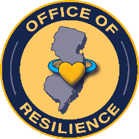













Thank You to Our Partners

Slide 16


Future Vision:
Strengthened
& Pruned Pathways,
Coordinated Effort
AI
K
OOR
K
K
K
K
K = Key Partners & License
Holders
OOR = Office of Resilience
AI = Ace Interface
= Trainers/Presenters
Branches in the Community

Slide 17

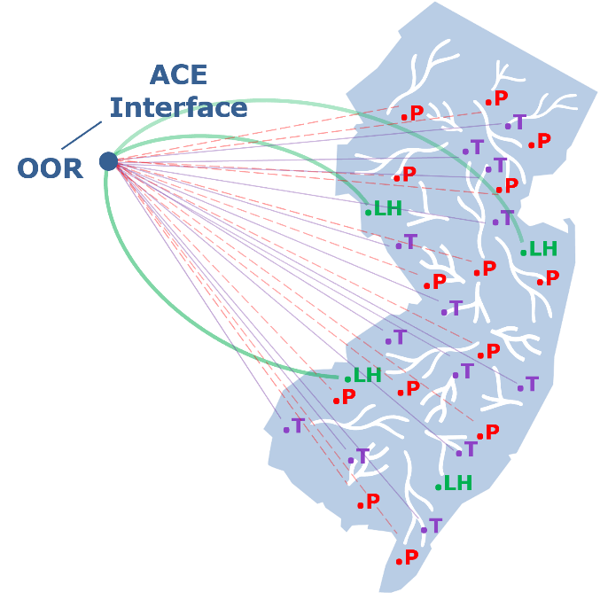
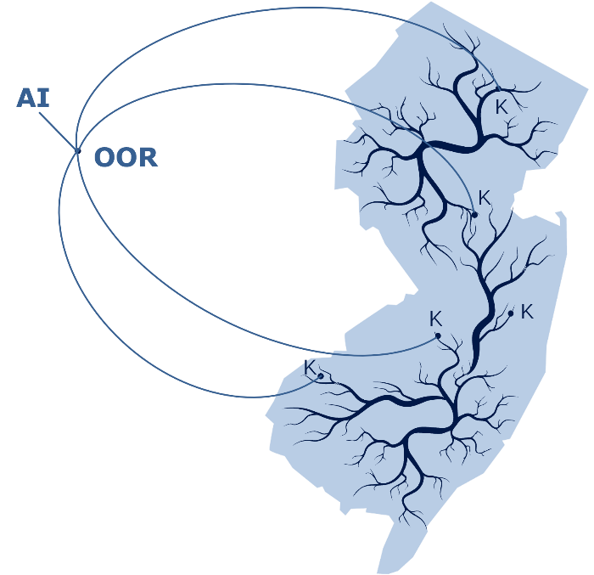
Emergent NEAR
Science Education
in NJ
Pre-Action Plan
NEAR Science Education Branching Abbreviation
in Pieces
Future Strengthened
& Pruned Pathways

Slide 18


Slide 19




THANK YOU
DCF.OFFICEOFRESILIENCE@DCF.NJ.GOV
50 E. STATE STREET
P.O. BOX 729
TRENTON, NJ 08625

