Slide 1
Toxic Stress: Impact of Adverse Childhood Experiences on Mental Health and Chronic Disease
Connecting ACEs data with with chronic diseases and their risk factors.
James Marks, MD, MPH

Slide 2
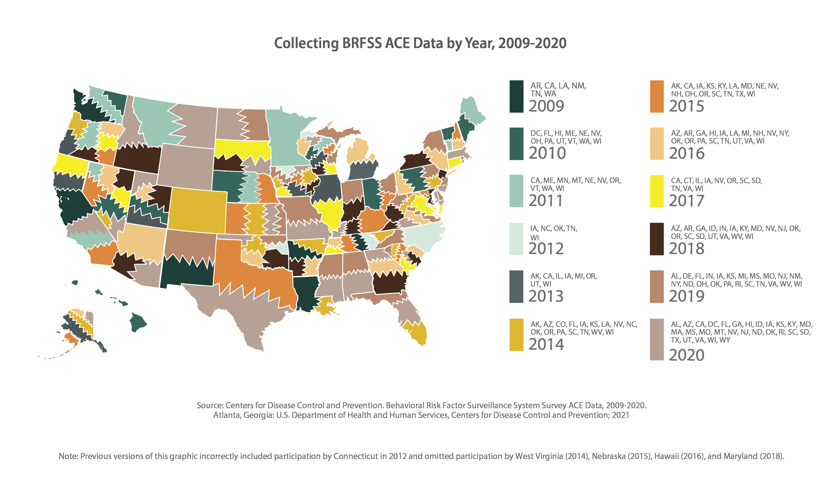

Slide 3
ACES and State Chronic Disease Directors
States have data to connect ACES prevalence with CD and their risk factors.
Information on key strategies/partners:
Communities (home visiting),
VA (PTSD, depression)
Addiction (tobacco, alcohol, opioids)
Injuries (abuse )
Convening and connecting with partners inside and outside HD

Slide 4
Major elements needed to catalyze change
Leadership and relationships
Big picture strategy
Surprising allies and unusual messengers
Information and examples of best practices

