Slide 1
Community e-Connect
Overview and Year 2 Opportunities

Slide 2
Purpose
Learn about an opportunity to work with NACDD to implement Community e-Connect (CeC), an electronic referral system linking clinical and community groups
Receive an update on CeC progress to date with Year 1 states
Explore opportunities for participating in Year 2

Slide 3
Contents
Community e-Connect Overview
What – definition
Who – roles
Why – rationale
Where – update on year 1 participants
How – methodology
Whether – evaluation and considerations
When – estimated timeline
Next Steps

Slide 4
The What
What is Community e-Connect?
Bi-directional linkage between clinical Electronic Health Records (EHRs) and community-based organizations (CBOs)
Based on open source software developed via a Massachusetts pilot funded through a CMS State Innovation Model grant
Can integrate with nearly any EMR
CBOs use the web-based e-Referral Gateway to receive referrals and send feedback reports
SOC2/HIPAA compliant
Notes:
A system that enables electronic communication between clinical groups and CBOs, data can flow in both directions, allowing CBOs to get a good picture of clients’ needs, and clinical providers to understand patients’ progress outside their practice or clinic walls.

Slide 5
The Who: Roles
Clinical providers
Determine appropriate referral candidates and refer for evidence-based services to meet patients’ clinical needs
CBOs
Receive referrals, document client status, send this information back to clinical organizations at agreed-upon intervals, enhancing the care continuum
State Health Departments (SHDs)
Oversee and convene involved parties, build relationships, develop evidence and promote the results
NACDD and Health-e-Link
Provide non-technical and technical guidance on implementation, respectively

Slide 6
The Why
The Why
Clinical Orgs | Decreases clinician burden by expanding the care continuum Enhances individual health outcomes, as well as population health Evaluates health outcomes / effectiveness of referrals to each intervention
CBOs | Increased client load / facility traffic Improved enrollment and retention rates due to provider referral / recommendation Solidifies collaboration with clinical entities in the area
SHDs | Provide partners with an innovative opportunity Address CDC’s referral-related strategies in 1815 and 1817 Evaluate the outcomes / results of partners and interventions you support
EMR Vendors | Support structured, bidirectional data exchange with external organizations Differentiate product offerings with an innovative approach to CBO referrals Demonstrate ability to send electronic referrals at point of care and acceptance of feedback reports, embedding data within the EMR
Notes:
Given the constraints on clinical care, expanding to collaborate with community partners who can develop capacity to support evidence-based program implementation will improve individual patient health, as well as population health overall.

Slide 7
The Why: Outcomes
In the Massachusetts’ example
More than 50 community / clinical linkages were established with over a dozen referral types
Nearly 5,000 referrals were made and over 8,000 feedback reports received
Analysis of HTN referrals showed significant increases in % of patients with controlled BP and reduced SBP

Slide 8
The Where: Year 1 Update
Year 1 Participant States
Delaware
Florida
Georgia
Hawaii
Missouri
Nevada
Each a various stages of implementation
Contracting and procurement at SHDs moves slowly
Early partner identification and buy-in critical
Beginning work with NextGen, Allscripts, Cerner, eClinical Works
Majority referring to DPP programs initially
Clinical organizations include medical centers, CHCs, practices groups, and local health departments

Slide 11
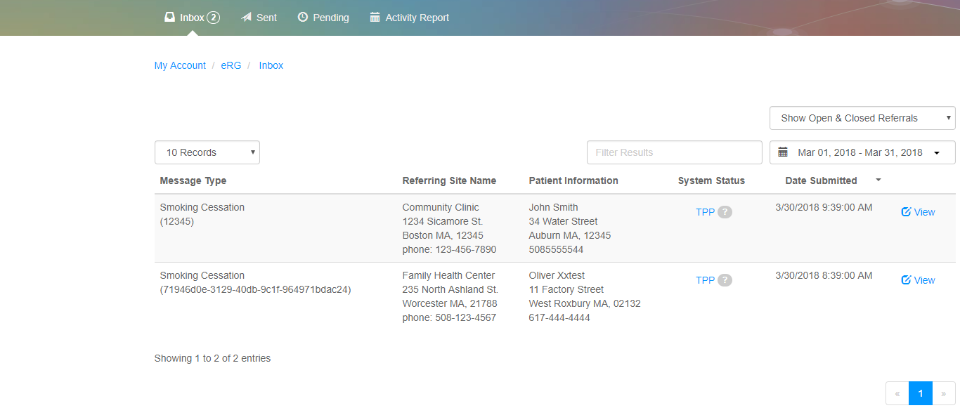
The How: e-Referral Gateway Screenshot

Slide 12
The How: Implementation Methodology
Get Ready
Get Set
Go Live
Define intervention and partners
Confirm legal referral agreement
Organizational forms complete
Kick off meeting and stakeholder buy-in
Determine e-Referral key contacts
Define workflows and data elements
IT assessment
Confirm eRG integrated workflows/data elements with stakeholders
Implement EMR enhancements and configure interfaces
Confirm implementation schedule / project plan
User training materials of eRG
Train staff
Transition to Production
Monitoring and Quality Control
Evaluation
Notes:
Though the IT-related processes of Community e-Connect are intimidating (at least to me and I’ve even done this before), the technical folks involved know what needs to happen and work together to get it done. It is the non-technical steps that are often the biggest time-suck and require a lot of legwork, collaboration, and agreement to do correctly. This is the process at a very high level.

Slide 13
The Whether: Evaluation
Aim for similar results to those achieved in MA
Data collection instruments for cross-site analysis
Metrics include:
Number of implementations, types, EMRs connected, and referrals
Health status for comparison to those eligible, but not referred
BMI, A1C
Systolic blood pressure
NACDD to provide template to capture and summarize data
Collaborate with SHD on data collection and analysis

Slide 14
The Whether: General Considerations
Do you have clinical and community partners who are interested, capable, collaborative and reliable?
Patient population, capacity, geography, language, access, etc.
Which interventions? Are you meeting a need? Does the CBO have capacity to receive referrals?
Participating SHDs should plan to implement referrals for pre-diabetes or diabetes and hypertension or cholesterol
Which EMR vendor do the clinical partners use? Is it one with whom we have worked previously?
Review the Readiness Assessment on the CeC webpage

Slide 15
The Whether: SHD Considerations
Costs:
~$70K for initial implementation; additional set-ups may be less
~$10-20K for maintenance phase (troubleshoot, data collection, hosting costs and lighter TA)
Recommend a project coordinator (~ .2 - .3 FTE) as well as ~.10 FTE for an epidemiologist
Dependent upon number of connections
Notes:
Will review on a case by case basis

Slide 16
The When: Estimated Timeframe
Phase I
Phase II
Phase III
Implementation wind down and initiate
maintenance
phase
2-4 months
3-6 months
1-3 months
Confirm intervention, establish legal agreements, determine workflow and finalize data elements
Conduct IT assessment and implementation at clinical sites
Hold trainings, go live with initial community/clinical linkages

Slide 17
The When: Sustainability
Goals
Now thru Year 3: build experience across clinical community organization types, EMR vendors, and evidence-based programs
Year 4 – 5: develop a modular approach to expansion and additional connections, building on work in early years
Expect decreasing costs as breadth and depth of experience widens and capacity to replicate expands

Slide 18
Next Steps
Review Readiness Assessment worksheet on CeC webpage
Email Susan Svencer (ssvencer@chronicdisease.org) if interested in participating in yare 2
Include a brief description of intended participation metrics: identified partners, interventions, past collaborations in this space, rationale for proposed structure
NACDD will review on a case by case basis and respond ASAP with questions

