Slide 1

NACDD School Health Council
Meet and Greet the
School Health Branch
September 24, 2013
Moderators:
Amy Greene, MPH, MSSW
NACDD School Health Consultant
Rachelle Johnsson-Chiang, MPH
NACDD School Health Consultant

Slide 2
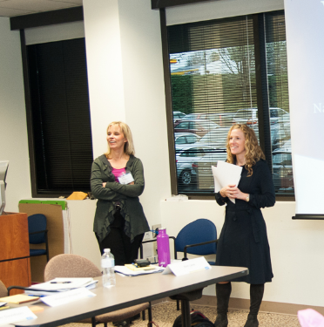
National Association of Chronic Disease Directors
NACDD’s School Health Project is a resource for people who have ever wondered how to tap into the resources of a health department and for those who currently work in a health department and want to know how to expand their reach in school health.
Notes:
Before we begin, I just wanted to talk a bit about NACDD and allow Whitney to share about NASBE. The National Association of Chronic Disease Directors improves the health of the public by strengthening state-based leadership and expertise for chronic disease prevention and control in states and at the national level. The School Health Project assists Chronic Disease Directors and their staff to make informed decisions about a variety of school health issues by providing technical assistance, up-to-date information and resources, and professional development. The project focuses on school health issues most directly related to preventing chronic disease - physical activity, nutrition and tobacco prevention programs. We are a resource for people who have ever wondered how to tap into the resources of a health department and for those who currently work in a health department and want to know how to expand their reach in school health.

Slide 3
Speakers
Holly Hunt, MA
Branch Chief, School Health Branch, Division of Population Health, National Center for Chronic Disease Prevention and Health Promotion
Melissa A. Fahrenbruch, M.Ed
Team Lead, Program and Professional Development, School Health Branch
Sarah Lee, PhD
Team Lead, Research Application and Evaluation , School Health Branch
Notes:
Before we begin, I just wanted to talk a bit about NACDD and allow Whitney to share about NASBE. The National Association of Chronic Disease Directors improves the health of the public by strengthening state-based leadership and expertise for chronic disease prevention and control in states and at the national level. The School Health Project assists Chronic Disease Directors and their staff to make informed decisions about a variety of school health issues by providing technical assistance, up-to-date information and resources, and professional development. The project focuses on school health issues most directly related to preventing chronic disease - physical activity, nutrition and tobacco prevention programs. We are a resource for people who have ever wondered how to tap into the resources of a health department and for those who currently work in a health department and want to know how to expand their reach in school health.

Slide 4




School Health Branch
Overview
National Center for Chronic Disease Prevention and Health Promotion
Division of Population Health

Slide 5
Division of Population Health
National Center for Chronic Disease Prevention and Health Promotion
Centers for Disease Control and Prevention
Office of the Director
Policy, Program Development,
Planning & External Relations
Associate Director for Science
Administrative Support
Applied Research and Translation Branch (ARTB)
Arthritis, Epilepsy and Well-Being Branch (AEWB)
Coordinated State Support Branch
(CSSB)
Epidemiology & Surveillance Branch
(ESB)
School Health Branch
(SHB)
Prevention Research Centers Team (PRC)
Healthy Aging Team (HAP)
Arthritis
Epilepsy
Quality of Life
Coordinated Chronic Disease Prevention (CCDP)
PHHS Block Grant
Analytic Methods Team
Epidemiology Support Team
Excessive Alcohol Use Prevention Team
Research Application & Evaluation Team
Program & Professional Development Team
National Center for Chronic Disease Prevention and Health Promotion
Division of Population Health

Slide 6
Division of Population Health
School Health Branch
Holly Hunt, MA--Branch Chief
Vacant- Deputy Branch Chief
Kavitha Muthuswamy, MPH---Health Communication Specialist
Rebekah Buckley, MPH, CRT, AE-C -CMS
Karyn Mitchell , Administrative Assistant (Contractor)
Tod Hebenton, Web Developer
Research Application and Evaluation Team
Health Scientists
Sarah Lee, PhD--Team Lead
Seraphine Pitt-Barnes, PhD, MPH, CHES
Caitlin Merlo, MPH, RD
Allison Nihiser, MPH
Shannon Michael, Ph.D, MPH
Edward Coffield, PhD.
Program and Professional Development Team
Health Education Specialists
Melissa Fahrenbruch, MEd--Team Lead
Bridget Borgogna, MEd
Jyotsna Blackwell, MPH
Kim Lane, Ph.D., RD
Caroline Pyle, MPH
Jennifer Kohr, MPH

Slide 7





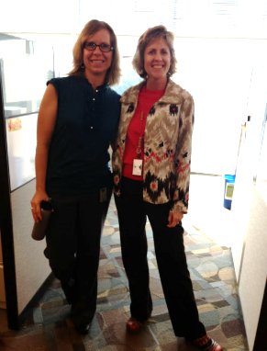

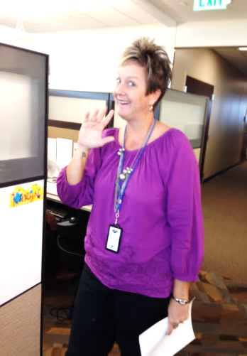






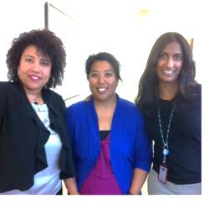






Slide 8
CDC’s Division of Population Health
School Health Branch
Key Priorities:
Increase quantity and quality of physical education and physical activity
Improve the nutritional quality of foods provided in school
Improve the capacity of schools to manage chronic conditions
Increase the number of schools implementing comprehensive tobacco-free policies
Notes:
Our goal is to help create healthy schools meaning an environment that supports the health and learning of students.
As many of you know, CDC has a long history of working with schools.
We work with state and local public health and education agencies on shared priorities:
Increase quantity and quality of physical education and physical activity in schools
Improve the nutritional quality of foods provided in school
Help schools to manage chronic conditions
Support schools in implementing comprehensive tobacco free policies
We work with our partners in education to:
Review science and research to develop evidence-based guidelines and recommendations for effective and feasible school programs and policy
Translate the science into tools and resources for educators and administrators
Training and professional development
Support quality health education
We encourage schools to implement all of these strategies within the framework of a CSH.

Slide 9



School Health Activities
The school health branch conducts the following activities to prevent chronic disease and promote the health of children and adolescents:
Funding and support
Research synthesis and translation
Evaluation
Professional development and training
Cross-cutting collaboration
Notes:
Provides funding and support to states, tribal g
Provides funding and support to states, tribal governments, large urban school districts, and national organizations to implement programs
Synthesizes and translates scientific research on the best strategies
Create tools and resources
Evaluates school-based policy, systems, environmental changes, and interventions
Provides professional development and training services through a training network on our tools and how to work with schools.
Collaborates with CDC programs, U.S. Dept. of Ed., U.S. Dept. of Agriculture, and other federal and national organizations.
You

Slide 10
FUNDING AND SUPPORT
NEW FOA:
State Public Health Actions to Prevent and Control Diabetes, Heart Disease, Obesity and Associated Risk Factors and Promote School Health
  Support implementation of evidence-based practices for:
    Healthier nutrition environments in schools
    Comprehensive school physical activity programs
    Capacity to manage chronic disease
  Fund public health departments in all 50 states and District of Columbia.
  Strengthen partnership between public health and education – MOU/MOA
Notes:
We have a new funding opportunity announcement in which we are working across categorical programs to support cross-cutting approaches to promote health and prevent and control chronic diseases and their risk factors. For school health this is a focus on childhood obesity. We know that children who are obese are more likely to have prediabetes and have risk factors for cardiovascular disease, such as cholesterol or high blood pressure.
Obese children are more likely to become obese adults at a higher risk for health problems such as heart disease, type 2 diabetes, stroke
As a result of this approach we will be able to support all 50 states and DC. While state health departments will be the recipient of the funds we expect all states to have or develop an MOU with the state education agency that demonstrates commitment to work together to address the health and academic needs of students.
Core strategies are focused on implementation – helping schools create healthier environments for students – professional development and training. We hope that administrators, educators, and others will become involved in this effort tap into the resources that will be made available through this initiative.

Slide 11



School Health Branch
Program and Professional Development Team
Notes:
Intramural reflects staffing, travel, etc.
Appropriation includes $488K directed to food allergy and anaphylaxis
Historically we received about $3M from NCEH’s asthma appropriation to implement to address school-based asthma management.

Slide 12



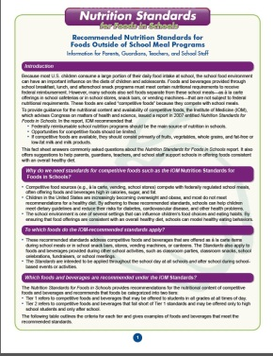
Healthy Nutrition Environment:
Policies and Practices
Nutritious and appealing school meals that comply with federal requirements
Marketing and promoting healthier foods and beverages
Standards for competitive foods consistent with the Institute of Medicine Nutrition Standards for Foods in Schools
Access to free drinking water
Implementation of strong local wellness policies
Notes:
Schools play a critical role in teaching healthy eating habits and also in supporting a setting where children have access to healthy options.
Students access food in schools in many ways – the school lunch line, food that is offered from vendors for lunch, vending machines and in classroom parties or school functions.
All of these foods make up the school nutrition environment and parents and schools can work to make sure that healthier foods are offered.

Slide 13




Quality Physical Education and Physical Activity
Comprehensive School Physical Activity Program (CSPAP)
Quality physical education as the foundation
Physical activity before, during, and after school
Staff involvement
Family and community engagement
Notes:
We know the benefits of physical activity and quality physical education in youth.
Physical education is the cornerstone of a comprehensive approach, however, physical activity before, during, and after school, staff involvement, and family and community engagement are all critical to a quality, comprehensive approach to physical activity. In addition to quality physical education, examples of activities that are implemented within a CSPAP are recess, classroom physical activity breaks, intramurals and physical activity clubs, interscholastic sports, walk and bicycle to school initiatives, and joint-use agreements.
We have developed guidelines to support schools in implementing programs to support both physical activity and healthy eating. In the next month of so we will put out a guide to implementing a CSPAP which will provide step by step guidance..
A CSPAP is a multi-component program that includes the following: quality physical education as the foundation, physical activity before, during, and after school, staff involvement, and family and community engagement. In addition to quality physical education, examples of activities that are implemented within a CSPAP are recess, classroom physical activity breaks, intramurals and physical activity clubs, interscholastic sports, walk and bicycle to school initiatives, and joint-use agreements.
Development and implementation of a CSPAP requires strong coordination and synergy across all of the components.
Quality or “enhanced” PE:
meets the needs of all students
is an enjoyable experience for all students
keeps students active for most of physical education class time
teaches self-management
teaches skills to maximize movement proficiency
emphasizes knowledge and skills for a lifetime of physical activity.

Slide 14
  Managing Chronic Conditions in Schools
  Chronic Conditions
  Asthma, Food Allergies and Anaphylaxis, Diabetes and other chronic conditions
  Policies, processes and protocols to meet daily management and emergency care needs of students with chronic conditions.
  Guidance
  Professional development and technical assistance
Notes:
Chronic diseases—including heart disease, cancer, stroke, diabetes, obesity, and related risk factors, such as tobacco use, physical inactivity, and poor diet—are the leading causes of death and disability in the United States, accounting for 7 of every 10 deaths. About one-fourth of people with chronic conditions have one or more daily activity limitations. In 2005, 133 million Americans – almost 1 of every 2 adults – had at least one chronic illness.
Another area of focus….
In recent years the prevalence of children and adolescents diagnosed with chronic conditions, including asthma, food allergies, and other activity, diet, and weight related conditions are also on the rise. Schools must be prepared to respond to the needs of students with chronic conditions. Schools can address the needs of students with chronic conditions by implementing policies, processes, and protocols that support both the daily management and emergency response needs of these students.
We have quite a bit of experience in addressing asthma management in schools and are nearing completion of guidelines to manage food allergies. Given the needs of schools in this area we are expanding our role in this area and will be developing additional guidance for managing chronic conditions and this work will also be supported with the state funding.
Applicant partners with the State Department of Education.
Applicant collaborates with other partners (e.g., the National Association of School Nurses, state-level affiliates of American Academy of Pediatrics, Food Allergy Research and Education, and state-level affiliates of National Assembly of School-based Health Care).
provides professional development and technical assistance to appropriate school staff on the processes and resources available to assist in the enrollment of eligible students with chronic conditions into private, state, or federally funded insurance programs.
provides professional development and technical assistance to LEAs and school health, mental health, and social services staff on processes and protocols for providing referrals to community-based medical care providers for students identified with chronic conditions or at risk for activity, diet, and weight-related chronic conditions.
develops protocols and provides technical assistance to LEAs and schools on the protocols for identifying students with chronic conditions. Processes to identify* students with chronic conditions may include, but are not limited to the use health room and attendance records to detect frequent school absences, frequent school health office visits, emergency room visits, or hospitalizations; parent and family communication of students’ conditions; and physician notifications.
Applicant provides professional development and technical assistance to appropriate school staff on the use of 504 Plans, Individualized Education Plans (IEPs), Individualized Health Plans (IHPs), or condition specific management plans, such as Asthma Action Plans, Food Allergy Management Plans, Diabetes Management Plans, as appropriate, particularly for health services, medication administration, and symptom management and also appropriate physical activity modifications in the school setting.
Applicant provides professional development and technical assistance to local education agencies (LEAs) and school staff on meeting the daily management and emergency care needs of students with chronic conditions.
Provide professional development to LEAs and school health, mental health, and social services staff on processes and protocols for providing condition specific self-management education to students identified with chronic conditions, such as: daily management of medication(s), response to asthma exacerbation, limiting exposure to a food allergen, or maintaining normal blood glucose levels.
Provide professional development to LEAs and school health, mental health, and social services on conducting and appropriately documenting ongoing assessments of the health status of students identified with chronic conditions, such as: periodic assessment of asthma control practices among students identified with asthma; inquiring about time since last seizure among students identified with epilepsy; or other direct measurement or student self-report to assess current health status.

Slide 15
National Non-Governmental Funded Partners
American Academy of Pediatrics (AAP)
American Association of School Administrators (AASA)
American Cancer Society (ACS)
Action for Healthy Kids (AFHK)
American Alliance for Health, Physical Education, Recreation and Dance (AAPHERD)
Food Allergy Research and Education (FARE)
National Association of State Boards of Education (NASBE)
National Association of Chronic Disease Directors (NACDD)

Slide 16
Training Tools for Healthy Schools
Training Tools for Healthy Schools provides workshops designed and delivered by qualified trainers to help improve school health policies, programs and curricula:
Health Education Curriculum Analysis Tool (HECAT)
Physical Education Curriculum Analysis Tool (PECAT)
School Health Guidelines to Promote Healthy Eating and Physical Activity (SHG)
School Health Index: A Self-Assessment and Planning Guide (SHI)

Slide 17


School Health Branch
Research Application and
Evaluation Team
Notes:
Intramural reflects staffing, travel, etc.
Appropriation includes $488K directed to food allergy and anaphylaxis
Historically we received about $3M from NCEH’s asthma appropriation to implement to address school-based asthma management.

Slide 18










What we do: Make research applicable and usable for practitioners

Slide 19






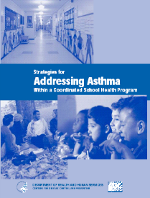
Examples of Existing Research Synthesis Projects
Notes:
Need to add asthma strategies (?), peer-reviewed manuscripts, journal article reviews,
CAITLIN and Allison-- where would your work with USDA on HHFKA go?
AN: I suggest putting our work with USDA on HHFKA into translation. LWP is a translation of the science. Also, we’re planning to create translation tools for this work.
CM: I agree and we should also mention under partnerships.

Slide 20






Examples of Existing
Research Translation Products
Notes:
Need to add financial implications, Guidelines PPT, & Exec Summary MIH, asthma toolkit, nutrition standards fact sheets, collaborations on federal reports (e.g. SGR on obesity) ; some should go on slide; others can be in our notes?
CM: I usually put the financial implication under synthesis. Are you okay with that?

Slide 21


Examples of Program Evaluation and Evaluation Research Work
Rapid Evaluations
Evaluability
Assessments
Evaluation Technical Assistance
Notes:
Rapid evaluation - Rapid evaluations are brief assessments of the process and impact of innovative initiatives. Rapid evaluation is conducted through technical assistance to agencies or organizations implementing these initiatives and answer questions of interest to them. Rapid evaluations involve non-experimental or quasi-experimental methods, with data collection typically lasting 12–24 months. Cost $250-$500K.
Evaluability Assessment – Early Assessment of Programs and Policies to Address Childhood Obesity – $2.6M project funded by RWJF. One component was to identify school-based initiatives ready for rigorous evaluation.
School-based evaluation TA –Work with a variety of entities sharing expertise on how to conduct school-based evaluations: US Surgeon General's office on the development of what is now called CORD- Childhood Obesity Research Demonstration Project; instrument development with school districts; evaluation design – DNPAO and Salad Bar Demonstration; evaluation tool development; Healthy Schools Program-Alliance for a Healthier Generation-Report review; Division of Violence Prevention.

Slide 22
Current scientific projects

Slide 23
A Sampling of Current Scientific Work
Evaluation of Comprehensive School PA program
Competitive food policy analysis
YRBS, NYPANS Manuscripts
Comprehensive school PA program guide
School Tobacco Guidelines
Urban PE resource briefs
Systematic Review on Managing Chronic Conditions in Schools
Competitive food policy case studies
LWP needs assessment & stories
Notes:
Here is a list of several descriptive and analytic studies we are part of, as either lead or co-authors.
In particular, I wanted to point out that we have a series of manuscripts that we are just beginning to work on using the 2010 National Youth Physical Activity and Nutrition Study data. We will be examining a number of different potential behavioral determinants and their relationship with dietary and physical activity behaviors.

Slide 24
Cross-Cutting Functions
(Dissemination, Technical Assistance, and SME)
Training Tools for Healthy Schools
Scientific Presentations
Technical assistance
Urban Physical Education Leadership Summit
Responses to internal and external requests
Cross-division collaboration (e.g., water access expert panel)

Slide 25
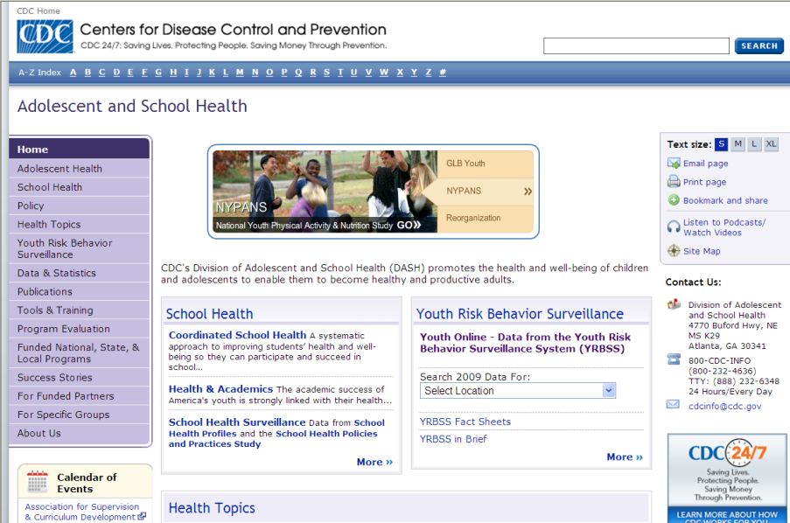
www.cdc.gov/healthyyouth

Slide 26
Thank You!
www.cdc.gov/HealthyYouth

