Slide 1



Fast, Free, Online: Because You Can’t Wait to Get Better

Slide 2
What Is A Whole Child Approach to Education?
“ASCD convened the Commission on the Whole Child
because we believe that the success of each learner can only be achieved through a whole child approach to learning and teaching,” said ASCD Executive Director Gene R. Carter.
“If decisions about education policy and practice started
by asking what works for the child, how would resources—time, space, and human—be arrayed to ensure each child’s success? If the student were truly at the center of the system, what could we achieve?”
Notes:
WCC 2006
Re evaluating education and schooling
During NCLB
1947
What’s good for the child
2007
Whole Child

Slide 3
What Is A Whole Child Approach to Education?
Plan to shift public dialogue about education from an academic focus to a whole child approach …
moving from one whose achievement is measured solely by academic tests to one who is knowledgeable, emotionally and physically healthy, civically engaged, prepared for economic self-sufficiency, and ready for the world beyond formal schooling.
Notes:
WCC 2006
Re evaluating education and schooling
During NCLB
1947
What’s good for the child
2007
Whole Child

Slide 4
Research and common sense
tell us when kids are ...
Unhealthy
Unsupported
Scared
Bored
Tuned Out
…they cannot become their best
Notes:
Mantra

Slide 5
Challenged
Supported
Engaged
Safe
Healthy
Notes:
Tenets
Abraham Maslow
EACH child, school, community
Deserves to be ….AND…

Slide 6
ASCD and the Whole Child approach understands that …
Students cannot learn unless they are
healthy and safe.
Subsequently they wont learn unless they are
engaged, supported, and challenged.
Notes:
Basic premise/understanding

Slide 7
2007
2011
2012
5 tenets
ASCD School Improvement Tool
Indicators
Notes:
2007 - 5 tenets of WC
Whole Child Tenets (link goes to slide at end of PPT with Tenets)
Each student enters school healthy and learns about and practices a healthy lifestyle.
Each student learns in an environment that is physically and emotionally safe for students and adults.
Each student is actively engaged in learning and is connected to the school and broader community.
Each student has access to personalized learning and is supported by qualified, caring adults.
Each student is challenged academically and prepared for success in college or further study and for employment and participation in a global environment.
2011 – 10 indicators each (plus Sustainability)
2012 – 6 components (linked back to School Improvement Process)

Slide 8
Tenets
Each student enters school healthy and learns about and practices a healthy lifestyle.
Each student learns in an environment that is physically and emotionally safe for students and adults.
Each student is actively engaged in learning and is connected to the school and broader community.
Each student has access to personalized learning and is supported by qualified, caring adults.
Each student is challenged academically and prepared for success in college or further study and for employment and participation in a global environment.

Slide 9
2007
2011
2012
5 tenets
Indicators
ASCD School Improvement Tool
Notes:
2011 – 10 indicators each (plus Sustainability)
Note: Indicators for Sustainability
2012 – 6 components (linked back to School Improvement Process)

Slide 10
2007
2011
2012
5 tenets
Indicators
ASCD School Improvement Tool
Notes:
2011 – 10 indicators each (plus Sustainability)
Note: Indicators for Sustainability
2012 – 6 components (linked back to School Improvement Process)

Slide 11
ASCD School Improvement Tool
http://sitool.ascd.org
Assess sustainable implementation of a whole child approach across school climate and culture, curriculum and instruction, family and community engagement, leadership, staff capacity, and assessment.
Guide decision making and set strategic goals and outcomes.
Identify resources to meet unique school and community needs.
Prepare your students for postsecondary education, meaningful employment, and active citizenship in a global society.

Slide 12


Slide 13

Notes:
ASCD profile (free)

Slide 14

Notes:
Indiv or School

Slide 15

Notes:
Global

Slide 16

Notes:
Positions

Slide 17
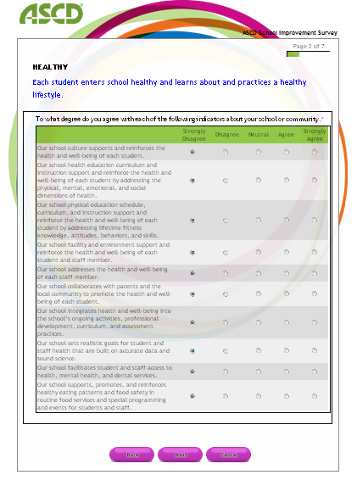
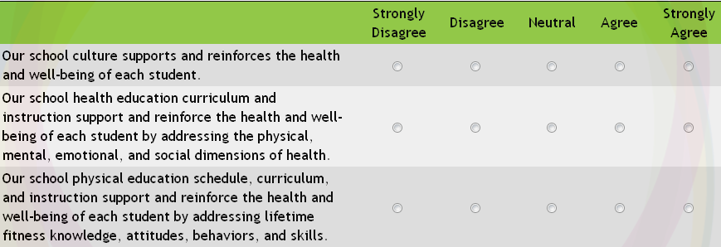


HEALTHY

Slide 18
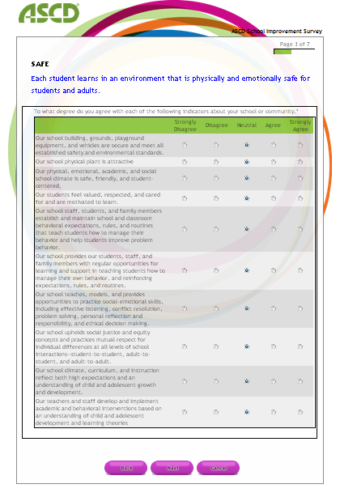
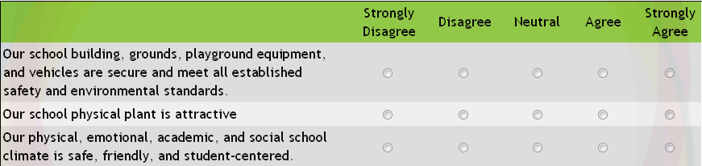

SAFE

Slide 19
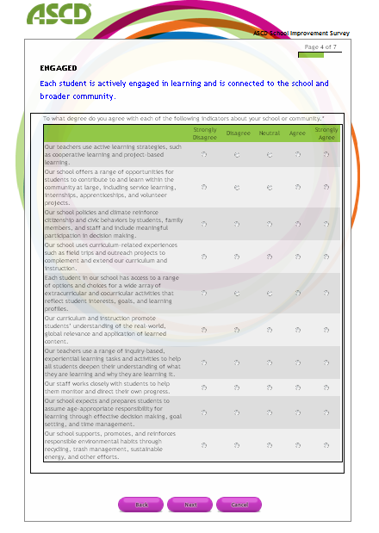
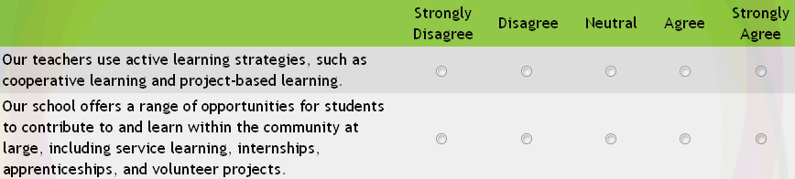
ENGAGED

Slide 20
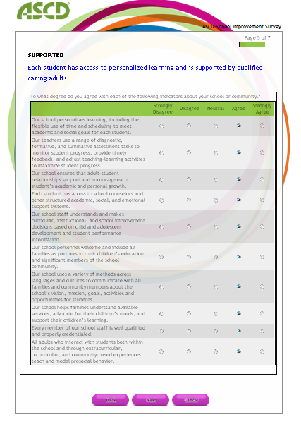
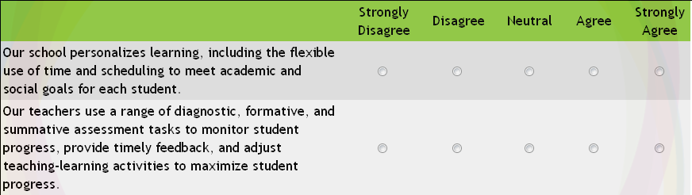
SUPPORTED

Slide 21
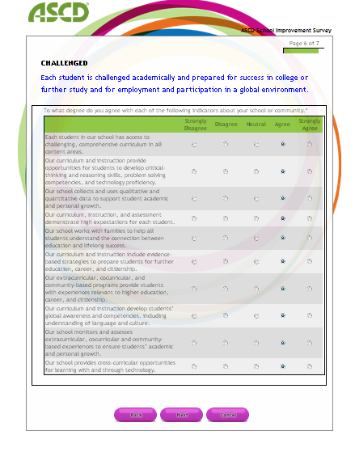
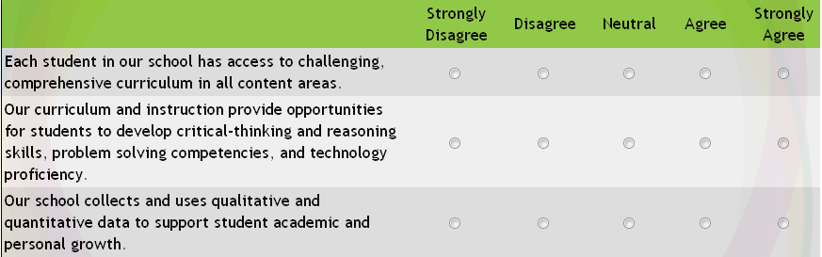
CHALLENGED

Slide 22
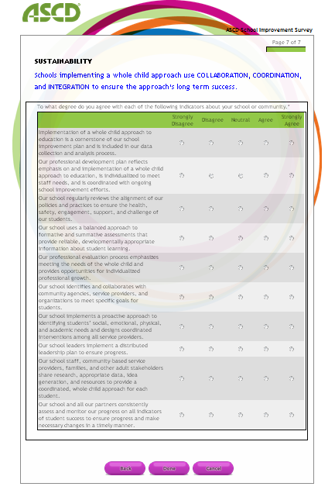

SUSTAINABILITY
Notes:
Emphasize Sustainability

Slide 23

*
NARRATIVE ANALYSIS
CHARTS
DEMOGRAPHICS
RESOURCES

Slide 24
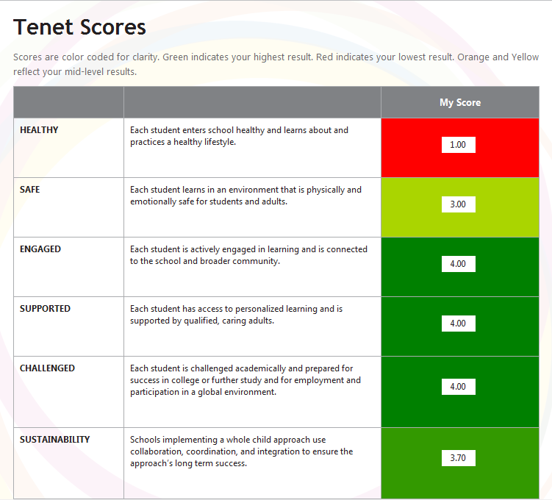
NARRATIVE ANALYSIS

Slide 25
NARRATIVE ANALYSIS
Tenets
Components
Healthy
Safe
Engaged
Supported
Challenged
School Climate & Culture
Curriculum & Instruction
Leadership
Family & Community
Engagement
PD & Staff Capacity
Assessment
Sustainability

Slide 26
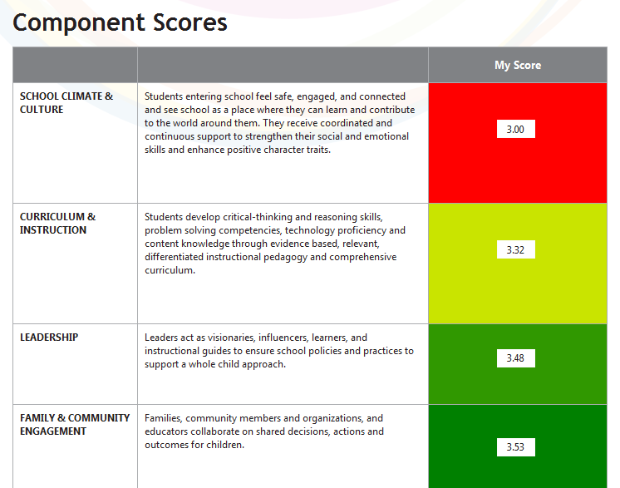
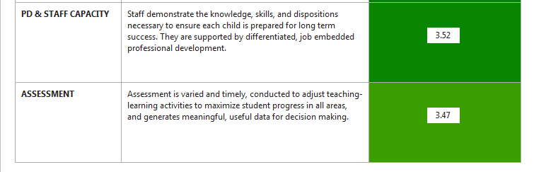
NARRATIVE ANALYSIS

Slide 27
NARRATIVE ANALYSIS
CHARTS
DEMOGRAPHICS
RESOURCES
*

Slide 28

Notes:
Specific resources
Free
Members
For purchase
Consultation
Edge (PLC)

Slide 29
Thank you
  Klea Scharberg
  Project Manager, Whole Child Programs
  kscharbe@ascd.org
  www.ascd.org
  www.ascd.org/wholechild
  www.wholechildeducation.org
  Twitter: @WholeChildAdv

Slide 30

RIASCD Whole Child Initiative
Presented to the
National Association of Chronic Disease Directors
School Health Council
December 6, 2012

Slide 31
RIASCD Whole Child Initiative
RIASCD learns of the Whole Child Initiative from ASCD’s Leader to Leader meeting in 2007
RIASCD recognizes and supports the critical connections between health and education, and identifies partners who are doing that work
RIASCD awarded Influence Grant from ASCD in 2009, 2010 and 2011.

Slide 32
Whole Child Tenets
HEALTHY SAFE
ENGAGED
SUPPORTED
CHALLENGED

Slide 33
Why a Whole Child Approach
Resonates across may professions: a cross disciplinary concept
Provides a public health context in education, can be individual or population based and speaks to consideration of environments (physical and social) and policies supporting developmental needs of youth

Slide 34
Why a Whole Child Approach
Addresses research demonstrating that accountability for education has increased within an environment of complex social problems
Complementary to traditional rigorous education based interventions to transform teaching and learning to meet the needs of all youth

Slide 35
Why a Whole Child Approach
Provides a context for addressing disparities in educational outcomes
Challenges educators and partners to consider broader implications of education reform

Slide 36
INFLUENCE GRANT KEY PROCESS COMPONENTS
2009-2010
Identify key potential partner organizations by reviewing the list of ASCD national partners and seeking out local counterparts.
Develop a needs assessment and gap analysis of policies and programs by aligning the tenets of the Whole Child within the RI education reform agenda. (Matrix and text))
Identify and analyze interrelationships among the tenets of the Whole Child and education reform efforts.
Convene community conversations to identify support and barriers to the Whole Child that will inform a collaborative local influence agenda.
      Conversations with adult groups of educators, administrators and counselors
      Conversations with student groups in Rhode island schools
Publish and disseminate a policy paper on state and local actions to facilitate incorporation of a Whole Child approach to education in RI.

Slide 37
RIASCD Whole Child Initiative
WHAT THE MATRIX
TOLD US

Slide 38
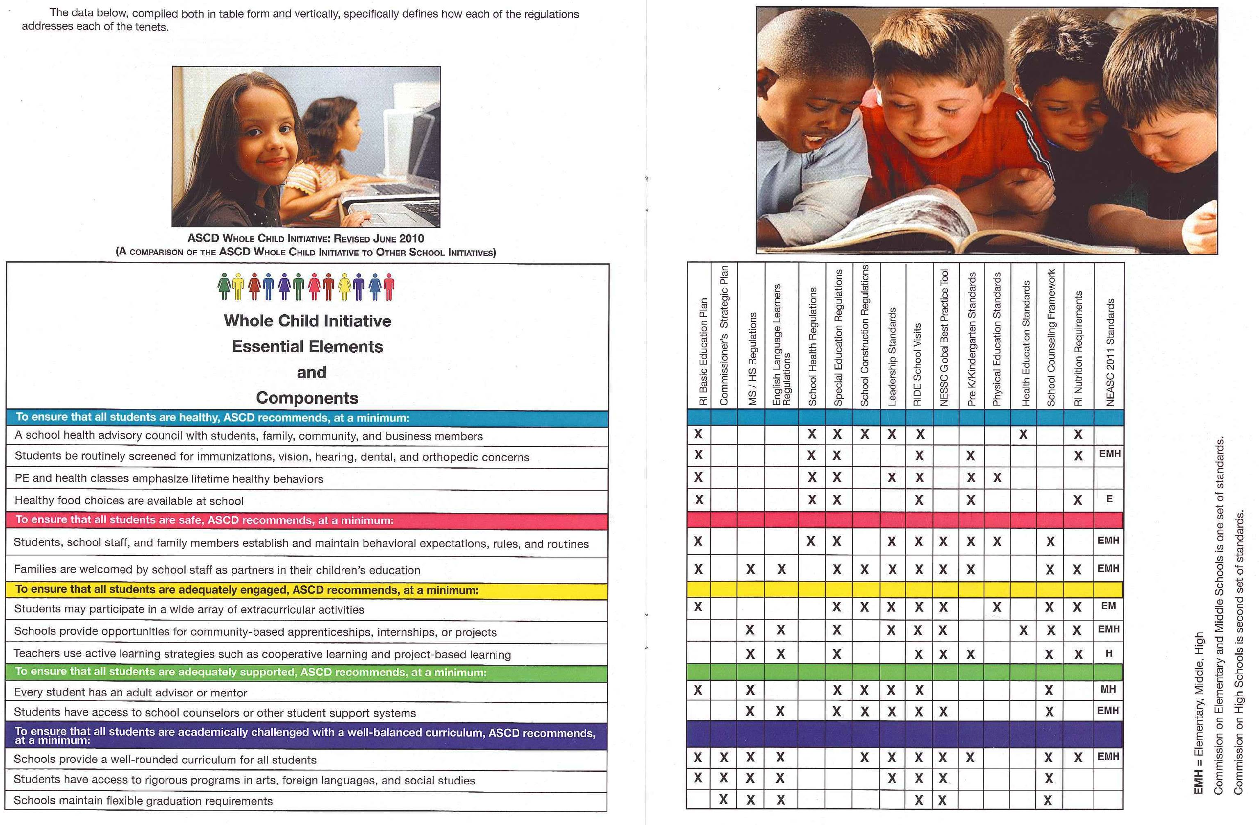

Slide 39
Community Conversations:
What Students Told Us
About Healthy Schools:
  Healthy relationships
  Physically active
  Emotionally healthy
  Positive atmosphere
  Knowing when to ask for help
  Substance free
About Safe Schools:
  Comfortable and safe surroundings
  Good peer and adult relationships
  Violence free
  Feeling accepted
  Protected and secure

Slide 40
About Supported Schools:
  Encouraged by parents/guardians/teachers/counselors/friends
  Feeling recognized for your accomplishments and achievements
  People who recognize your struggles and effort
  Advisories
  People who care about you
About Engaged Students:
  Interactive, hands-on activities
  Lots of options
  Open discussions when teachers ask for student input
  Having a choice in classes and in how and what is learned
  Joining activities (S. Council, band, debate, sports, theater)
  When teachers get involved and excited, you do also
  Creative types of learning

Slide 41
About Challenging Students
  Learning things outside of your comfort zone
  Gaining new experiences
  Becoming involved in and out of the classroom
  Pursuing your goals, dreams, and beliefs in spite of obstacles or opposition
  Common tasks and digital portfolios
  PBGRs (Performance Based Graduation Requirements)
  Rigor
  Working harder to reach your goal
  Expectations
  Obstacles

Slide 42
RIASCD Whole Child Initiative
How a Whole Child Approach Can Transform Education in Rhode Island
Policy Analysis and Action Agenda

Slide 43
WHAT WE HAVE LEARNED:
Basic Education Plan offers an opportunity to capture the essence of the Whole Child initiative
Fidelity of implementation is critical
Students understand the significance of a Whole Child approach in education
Strengthening of partnerships is fundamental; partnerships offer CHALLENGES and OPPORTUNITIES for moving the work ahead

Slide 44
RECOMMENDATIONS:
Sharing best practices among schools within districts, between communities, among states
Focus on sustainability
Pay attention to consolidation of resources
Whole Child approach as a FRAMEWORK for reform and a way to inform and activate local leaders

Slide 45
NEXT STEPS….
Promote Whole Child Resolution with RI legislators
Promote Whole Child Framework with RI Congressional Delegation
Sustain Whole Child Recognition Program in Rhode Island (First announcement 9/2012)
Deepen and broaden partner relationships

Slide 46
RIASCD Whole Child Initiative
Please join us at www.riascd.org for
Rhode Island Whole Child Initiative updates
Contact information
Rosemary Reilly-Chammat, Ed.D. rosemary.reilly-chammat@ride.ri.gov
Elizabeth Brito egbrito@aol.com

