Slide 1
NACDD PRESIDENT’S CHALLENGE
Health Equity: Getting to Ground Zero
Namvar Zohoori, MD, MPH, PhD
NACDD President
Chronic Disease Director and Associate Director for Science
Arkansas Department of Health

Slide 2
Health Equity: Getting to Ground Zero
Three Elements
Echo and support the ASTHO 2016 President’s Challenge:
“Advancing Health Equity & Optimal Health for All”
Getting to Ground Zero
Greater involvement and interaction between NACDD and Members, specifically around the issue of Health Equity

Slide 3
Why Chronic Disease Directors Need to be Involved
Chronic Diseases
Infectious Diseases
Accidents & Injuries
All Other Causes
Deaths in The U.S.

Slide 4
Why Chronic Disease Directors Need to be Involved
Chronic Diseases
- Comprise 70% of all diseases;
- Carry some of the most disparate disease burdens;
State Chronic Disease staff have the ability to engage and work with multiple partners within their Coalitions, Taskforces, Committees, etc.
Therefore, state Chronic Disease programs and staff can contribute much to promoting health equity.

Slide 5
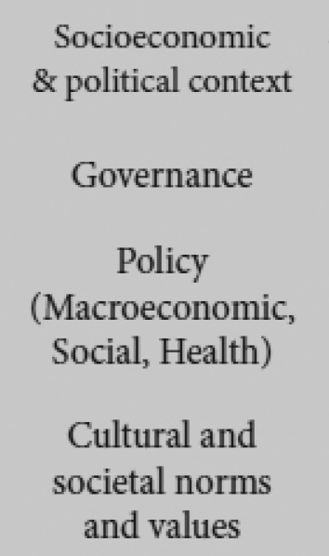
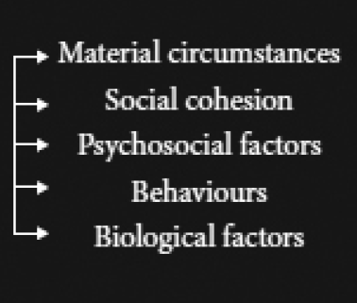
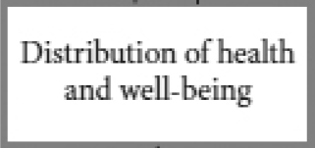
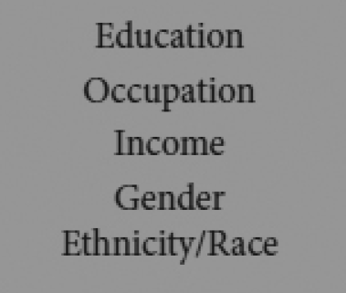
WHO Framework for Social Determinants of Health
Material circumstances
Social cohesion
Psychosocial factors
Behaviours
Biological factors

Slide 6
The Core Paradox…
“The belief…is that by due skill an ill-working humanity may be framed into well-working institutions.
It is a delusion. The defective natures of citizens will show themselves in the bad acting of whatever social structure they are arranged into.
There is no political alchemy by which you can get
golden conduct out of leaden instincts.”
Herbert Spencer, ‘The Man versus the State’, 1884

Slide 7
Unequal Treatment: Confronting Racial & Ethnic Disparities in Health Care

Slide 8
Differences, Discrimination & Disparities: What’s the Difference?
Clinical Appropriateness
and Need
Patient Preferences
Non-Minority
Difference
The “Ecology” of
Health Care Systems and
Environmental Factors
Quality of Health Care
Minority
Disparity
Discrimination: Biases and
Prejudice, Stereotyping, and
Uncertainty
Populations with Equal Access to Health Care
Gomes and McGuire, 2001

Slide 9
Unequal Treatment: Major Findings
Racial/Ethnic disparities consistently found across a wide range of:
- Health care settings
- Disease areas
Clinical services
Even when various confounders are controlled for (stage of presentation, co-morbidities, severity of disease, age, SES, insurance)
Are associated with higher mortality among minorities
Unequal Treatment: Confronting Racial and Ethnic Disparities in Health Care, 2003

Slide 10
Unequal Treatment:
The IOM Charge
Assess the extent of racial and ethnic differences in healthcare that are not otherwise attributable to known factors such as access to care.
Evaluate potential sources of racial and ethnic disparities in healthcare, including the role of bias, discrimination, and stereotyping…

Slide 11
Bias: No evidence that providers more likely than general public to express bias
Stereotyping: Evidence of ‘cognitive shortcuts’
Unequal Treatment: Confronting Racial and Ethnic Disparities in Health Care, 2003

Slide 12
Stereotyping…“process by which people use social categories (e.g. race, sex) in acquiring, processing, recalling information about others.”
Unequal Treatment: Confronting Racial and Ethnic Disparities in Health Care, 2003

Slide 13
Stereotyping
Prejudgment
Prejudice
Discrimination
Oppression

Slide 14
Stereotyping
Prejudgment
Prejudice
Characteristics of Prejudice
Based on little or no experience
Learned from all levels of society
Everyone has them
“Absence” of info just as important
Positive or negative
Instantaneous & at pre-cognitive level
Have “range of emotions” attached to them
Self-reinforcing

Slide 15
Stereotyping
Prejudgment
Prejudice
Discrimination
Characteristics of Discrimination
Based on prejudice
Everyone does it
Positive or negative
Have “range of actions” attached to them
Self-reinforcing

Slide 16
Stereotyping
Prejudgment
Prejudice
Characteristics of Oppression
Historical
Institutional
Ideological
Dominant Group Privilege
Goes only one way
Forces are interlocking and deeply woven
Internalized dominance
Internalized oppression
Positionality
Discrimination
Oppression
Racism
Classism
Sexism
Ageism
Ableism

Slide 17
Stereotyping
Prejudgment
Prejudice
Discrimination
Individual Level
Oppression
“Ground Zero”
Racism
-
Classism
Sexism
Ageism
Societal Level
Ableism

Slide 18
Evidence that Biases and Stereotypes Influence Encounters
Found in
Clinical settings
- Hospitals
- Clinics
- Medical, nursing and pharmacy
students
Educational settings
Employment and work settings
Social settings

Slide 19
The Implicit Project
https://implicit.harvard.edu/implicit/demo/takeatest.html

Slide 20
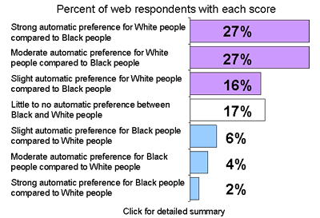
The Implicit Project…

Slide 21
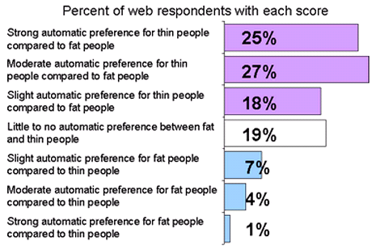
The Implicit Project…

Slide 22
The Implicit Project…
Findings
Implicit biases of all forms are pervasive
People are often unaware of their implicit biases
Implicit biases predict behavior
People differ in levels of implicit bias
Implicit biases can be changed

Slide 23
One of the recommendations from the IOM report
“…education may be one of the most important tools as part of an overall strategy…”
“…healthcare providers should be made aware of racial and ethnic disparities in healthcare, and the fact that these disparities exist, often despite providers’ best intentions.”
“…all current and future healthcare providers can benefit from cross-cultural education .”
Unequal Treatment: Confronting Racial and Ethnic Disparities in Health Care, 2003

Slide 24
What NACDD Brings To The Table
Health Equity Council
Tools and toolkit(s);
Technical assistance to states and their partners;
Consultancy work from the Council and others.

Slide 25
Existing NACDD Resources
Assessments:
Health Equity at Work
State Health Department Organizational Assessment
Health Equity Impact Review
Fact Sheets:
SDOH Fact Sheet
Advocacy Fact Sheet
Cultural Competency Fact Sheet
PowerPoint Presentations:
SDOH Power Point
LGBT 101 Presentation

Slide 26
Existing NACDD Resources
Community Action Guides:
Food Deserts to Food Oases
High School Dropout as a PH Issue
Neighborhood Segregation
HE Tools for SHD:
Health Equity Model Language
Linking Health Inequities to 10 Essential Public Health Services
Promising Practices to Reduce Inequity
Public Health Roles for Action to Reduce Health Inequities

Slide 27
Recommendations for State Action
Initially
Work with your SHO to synergize CDz HE work with SHD efforts
Perform
Health Equity at Work Assessment
SHD Organizational Assessment
Limited Funding
Access existing tools and resources
NACDD website
ASTHO website
CDC SDOH and The Community Guide websites

Slide 28
Recommendations for State Action
If funding available:
NACDD can provide training and education on health equity and the social determinants of health.
NACDD State CDz Academy
NACDD Course Catalog
Institutional Equity Curriculum
(Available Spring 2016)

